Slide 1

Weather_analysis_capstone_project
By Moumita Biswas

Slide 2

Contents
Introduction of Data
Data cleaning & MECE breakdown
Understanding & solving PowerBI questions
Creating a dynamic Dashboard
Understanding & solving EDA questions
Conclusion about my understanding about this data

Slide 3

Introduction of data
This weather analysis dataset compiles a comprehensive range of meteorological parameters, including temperature, precipitation, wind speed, and atmospheric pressure, providing a thorough examination of weather patterns over time and space. With its detailed insights, it serves as a vital tool for researchers, policymakers, and industries seeking to understand and adapt to changing climate conditions. By leveraging this data, stakeholders can make informed decisions in areas such as agriculture, infrastructure planning, and emergency response, ultimately enhancing resilience and sustainability in the face of climate variability and extremes.

Slide 4

Insights from this data
Before diving into the specific questions, it's crucial to outline the potential insights we aim to derive from the weather data analysis. Firstly, we seek to understand global geographical patterns, examining how cities are distributed based on latitude and longitude coordinates. This analysis can shed light on urbanization trends and population density across different regions. Additionally, exploring climate variability across continents will provide insights into regional weather patterns. By analyzing temperature, humidity, wind speed, and air pressure trends over time, we aim to identify patterns, anomalies, and extreme weather events. Moreover, correlational analysis between weather variables can reveal their interplay and potential impacts. Spatial and temporal analyses will allow us to visualize variations and trends in weather conditions across different geographical locations and timeframes. Ultimately, through comparative analysis and impact assessment, we can understand the implications of weather conditions on various sectors and develop predictive models for future weather trends.

Slide 5

Overview of Weather_analysis dataset
City Attributes: Gain vital context about each city's location (latitude, longitude), country, and name.
Humidity: Dive into hourly humidity levels for each city, uncovering patterns and seasonal shifts.
Pressure: Chart air pressure fluctuations across all cities, potentially predicting weather changes.
Temperature: Unveil temperature trends, delve into heatwaves or cold spells, and correlate temperature with energy consumption.
Weather Descriptions: Understand the qualitative aspects of weather through hourly textual descriptions for each city.
Wind Direction: Track wind patterns, anticipate potential wind events, and explore the link between wind direction and factors like pollution dispersion.
Wind Speed: Uncover crucial insights into wind patterns, predict potential hazards, and study the impact of wind speed on various activities.

Slide 6

Data cleaning
There were many null values almost in each attributes, replaced those values with `N/A’
After processing the raw data, made a new dataset called `Weather_analysis_transformed’
Inside the dataset, made four lookup tables:
City_lookup
Country_lookup
Date_lookup
Time_lookup
Made a fact table, called Final_fact, including 3 foreign keys

Slide 7

Overview of Weather_analysis_transformed dataset
City_attributes – Gain vital context about each city's location (latitude, longitude), country_id, and city_id
City_lookup – Each city’s name & id
Country – Each country’s name & id
Date_lookup – 5 years (2012 -2017) date & date_id
Final_fact – 5 years data of humidity, temperature, air_pressure, wind_speed, wind_direction, weather_description along with city_id, date_id & time_id
Time_lookup – Time in hour and time_id

Slide 8
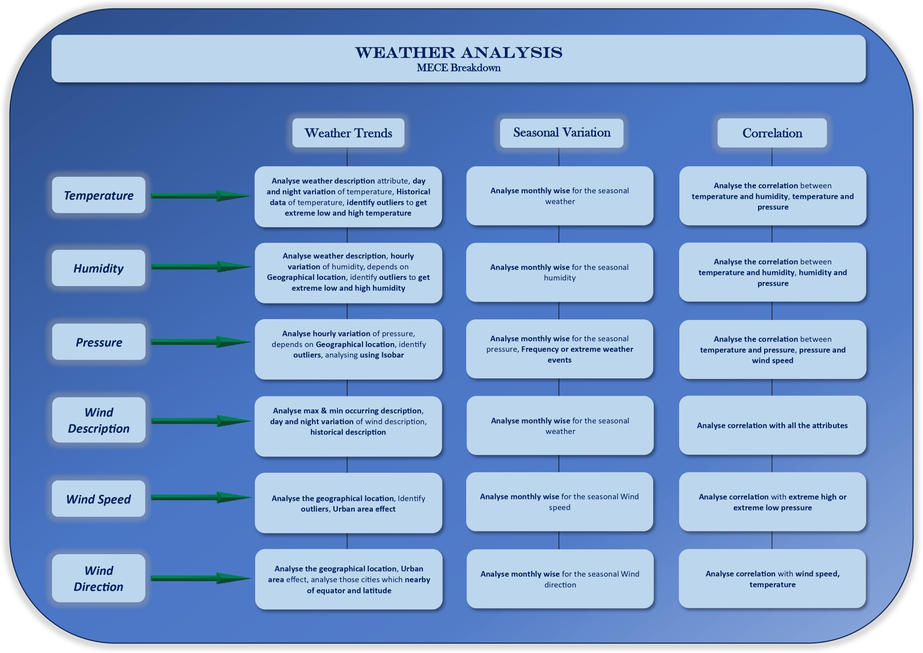
MECE Breakdown
After understanding the data I’ve create a MECE breakdown for better understanding & to proceed further.

Slide 9

Understanding & solving PowerBI questions
To achieve a profound grasp of the dataset, I delved into 15 questions utilizing PowerBI. Let's navigate through them comprehensively.

Slide 10
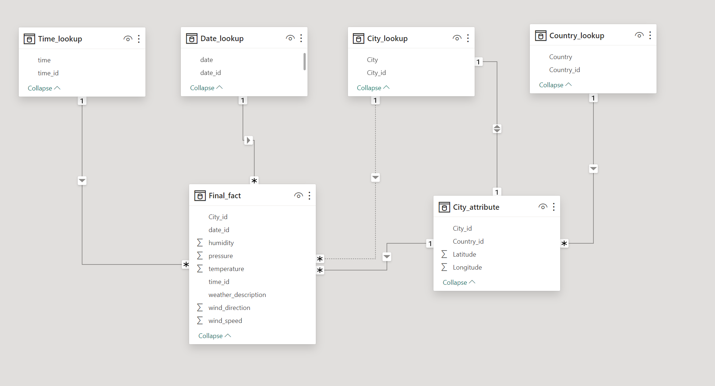
ER-Diagram for weather_analysis_transformed dataset

Slide 11
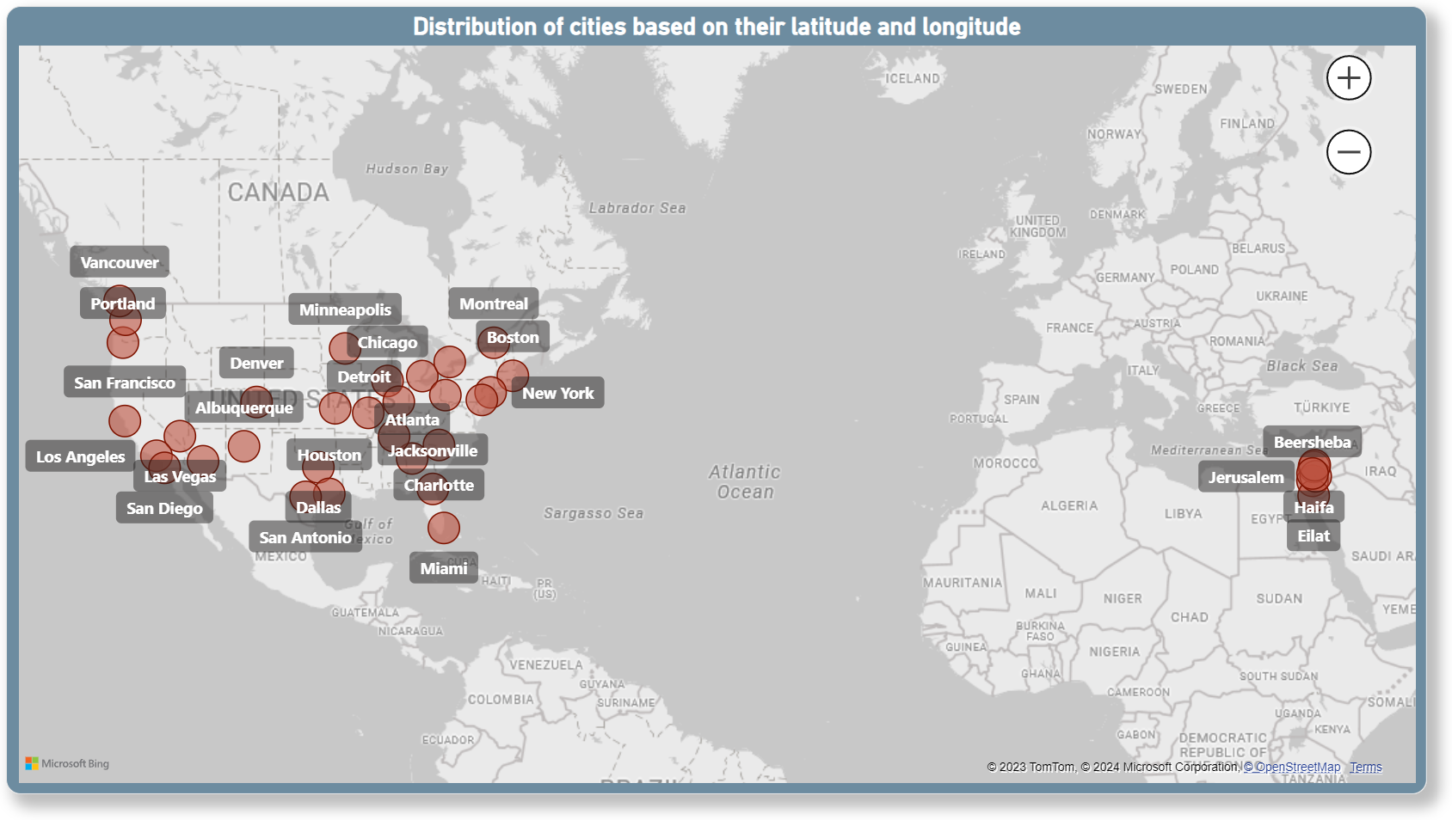
1. Can you create a geographical map in Power BI showing the distribution of cities in the dataset based on their latitude and longitude?
Created a geographical map to show the distribution of cities base on their latitude and longitude.

Slide 12
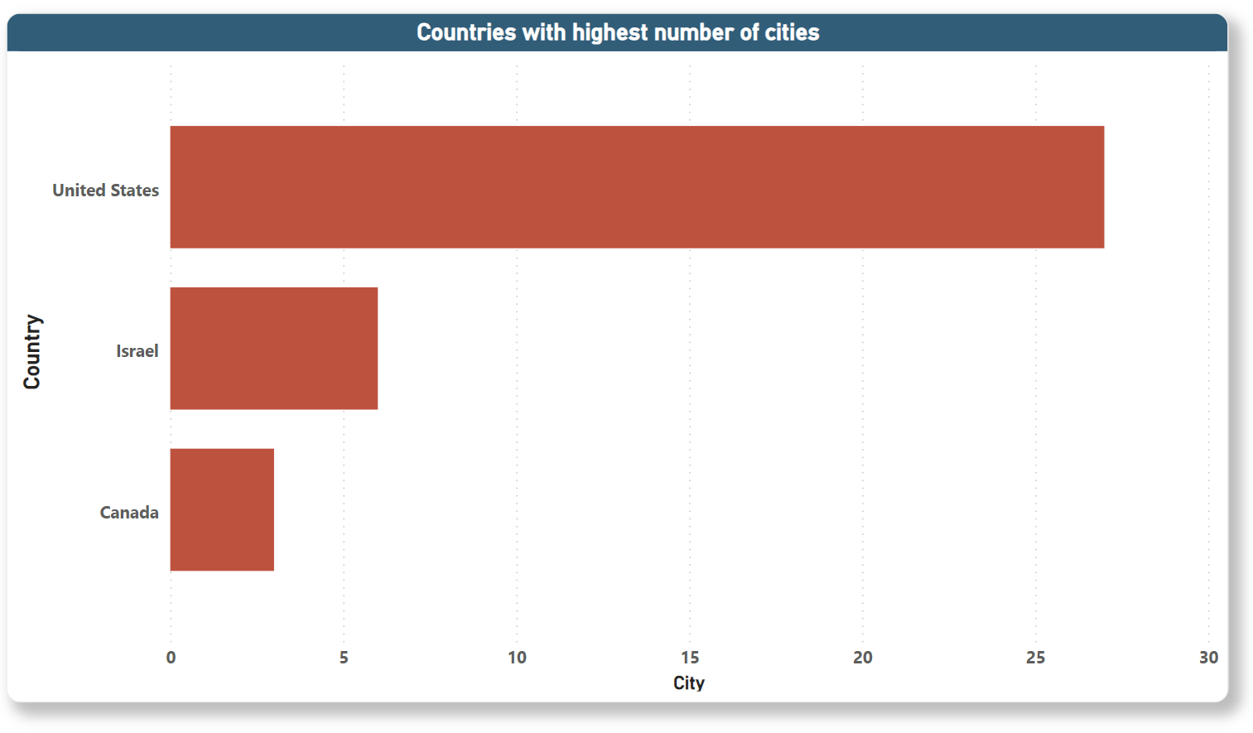
2. In Power BI, can you create a bar chart representing the top 10 countries with the highest number of cities in the dataset?
Unfortunately, we have only 3 countries consisting 36 cities. So, here I created a bar chart to show the countries in descending order to get the country with highest number of cities.

Slide 13
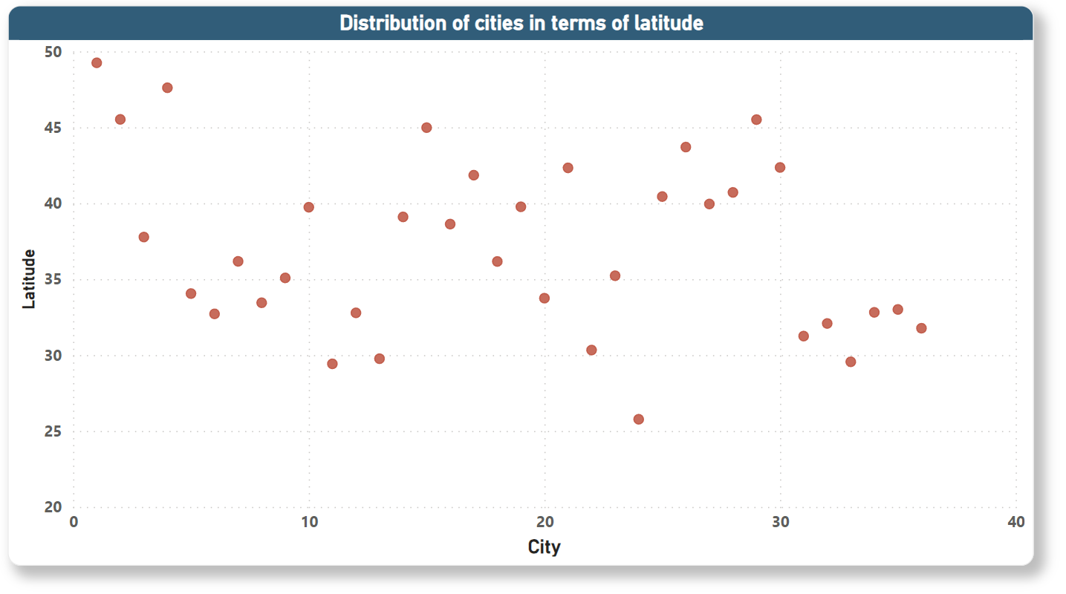
3. How does the distribution of cities in terms of latitude vary across different continents? Create a scatter plot in Power BI to illustrate this.
Created a scatter plot to show the distribution of cities in terms of latitude.

Slide 14
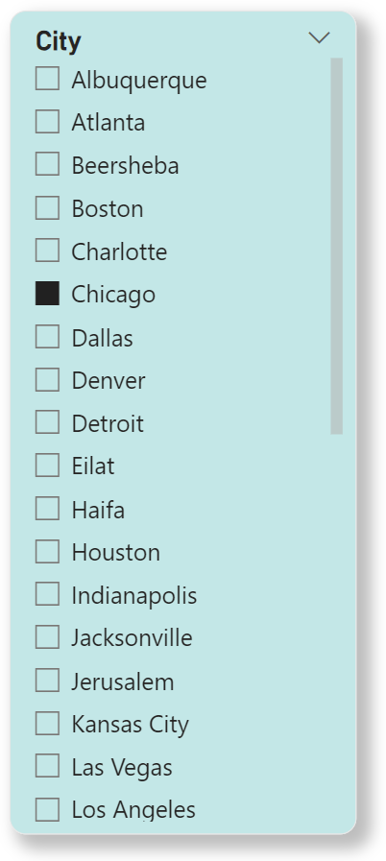
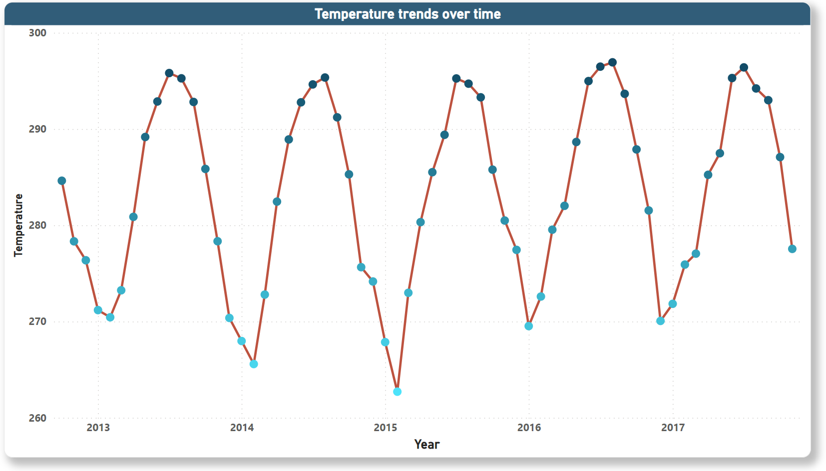
4. Create a line chart in Power BI to display the temperature trends over time for a selected city. Highlight extreme temperature events.
Created a line chart to show the temperature trends over time, highlighted highest to lowest points in the line as the temperature going. to select a specific city created a city slicer.

Slide 15
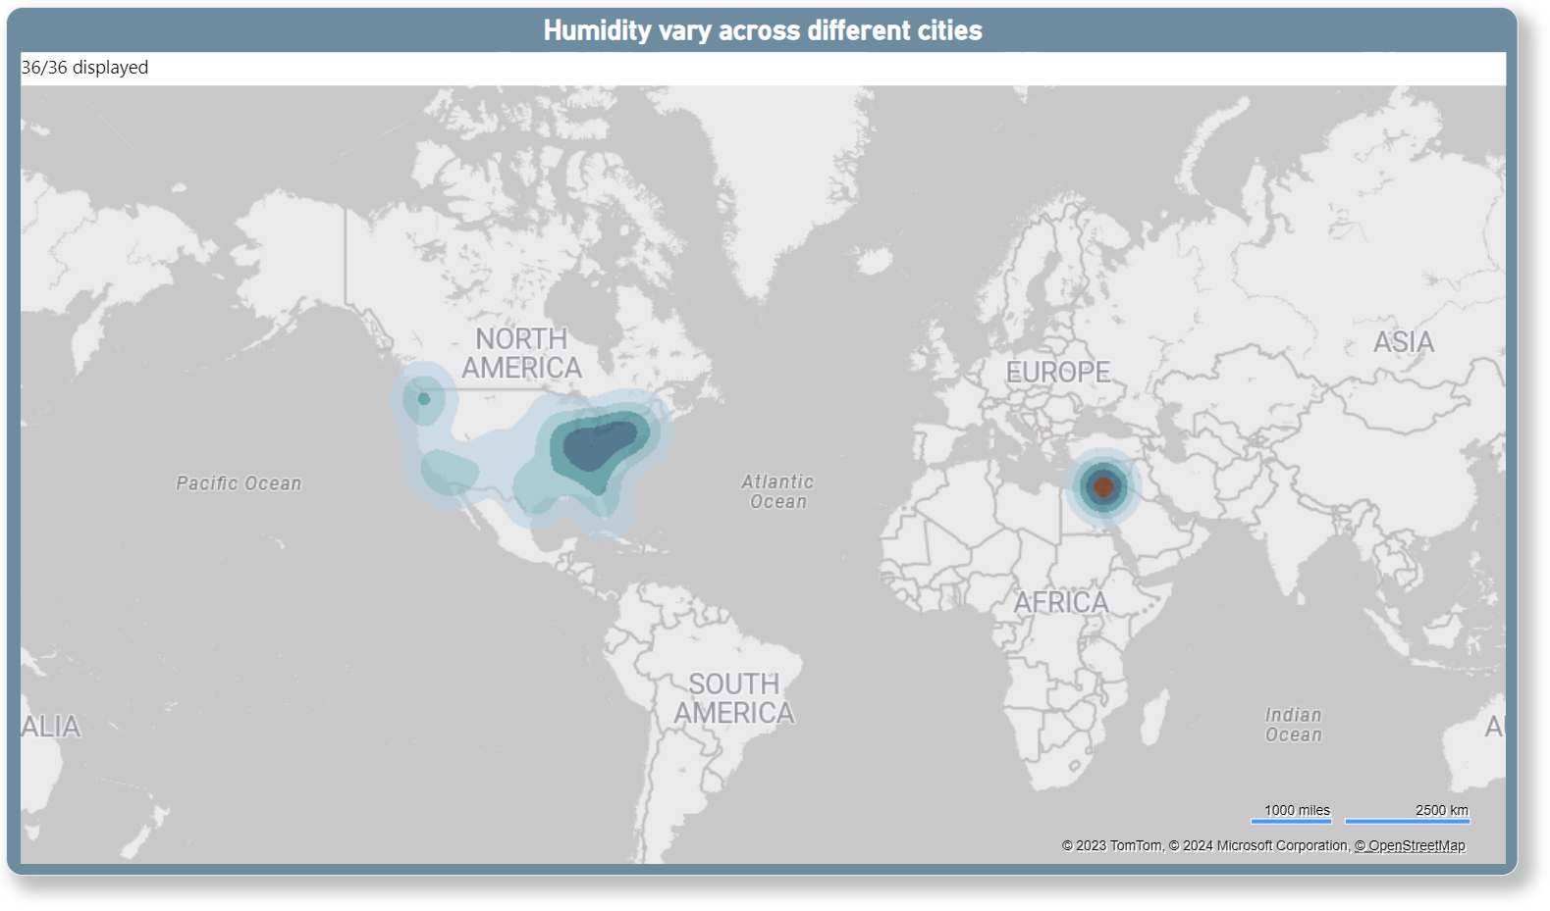
5. How does humidity vary across different cities? Generate a heatmap in Power BI to visualize this variation.
Created a heatmap to show the clusters of humidity across different countries. The deepest brown color showing the max humidity level, and light green to dark green showing here the lowest to 2nd highest humidity level.

Slide 16
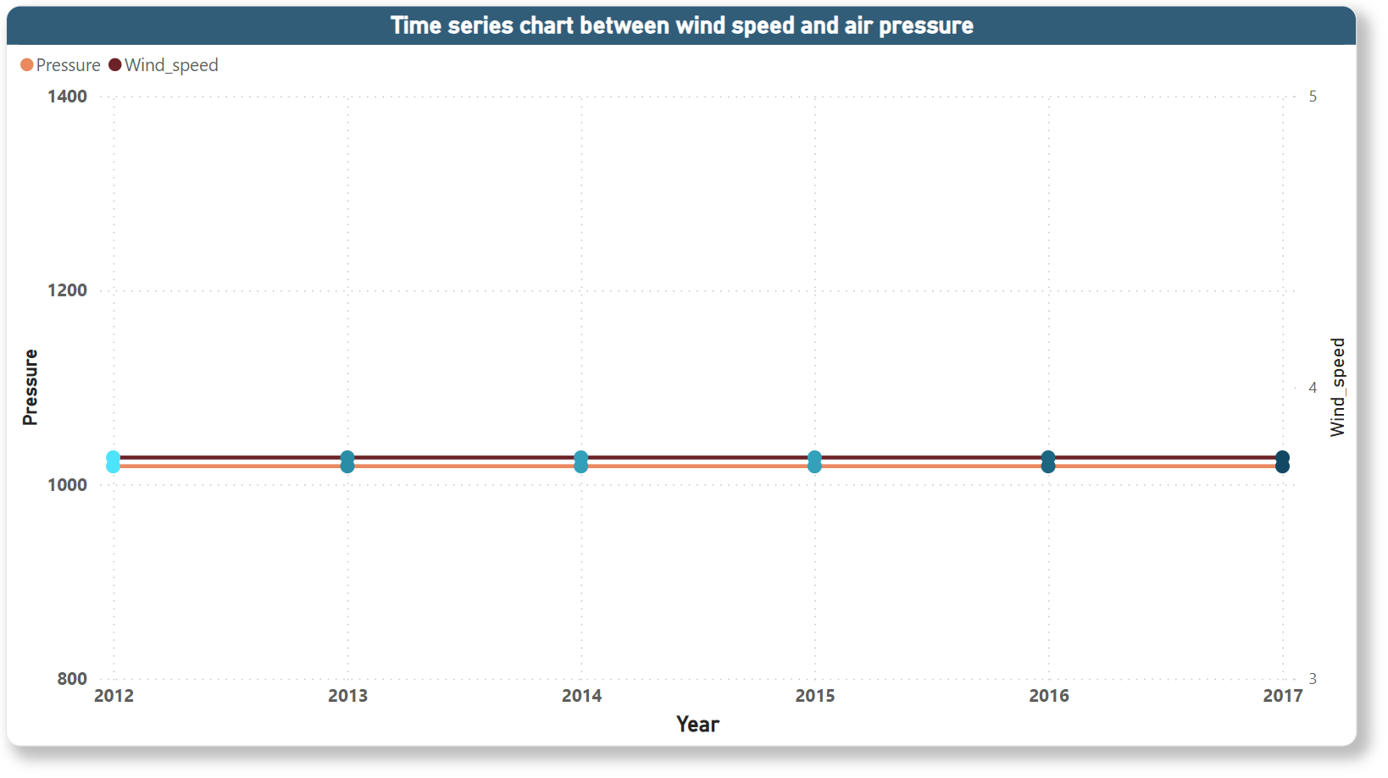
6. Can you create a time-series chart in Power BI showing the relationship between wind speed and air pressure for a specific city?
Created a time series line chart to show the relationship between wind speed and air pressure, to select a specific city created a city slicer.

Slide 17
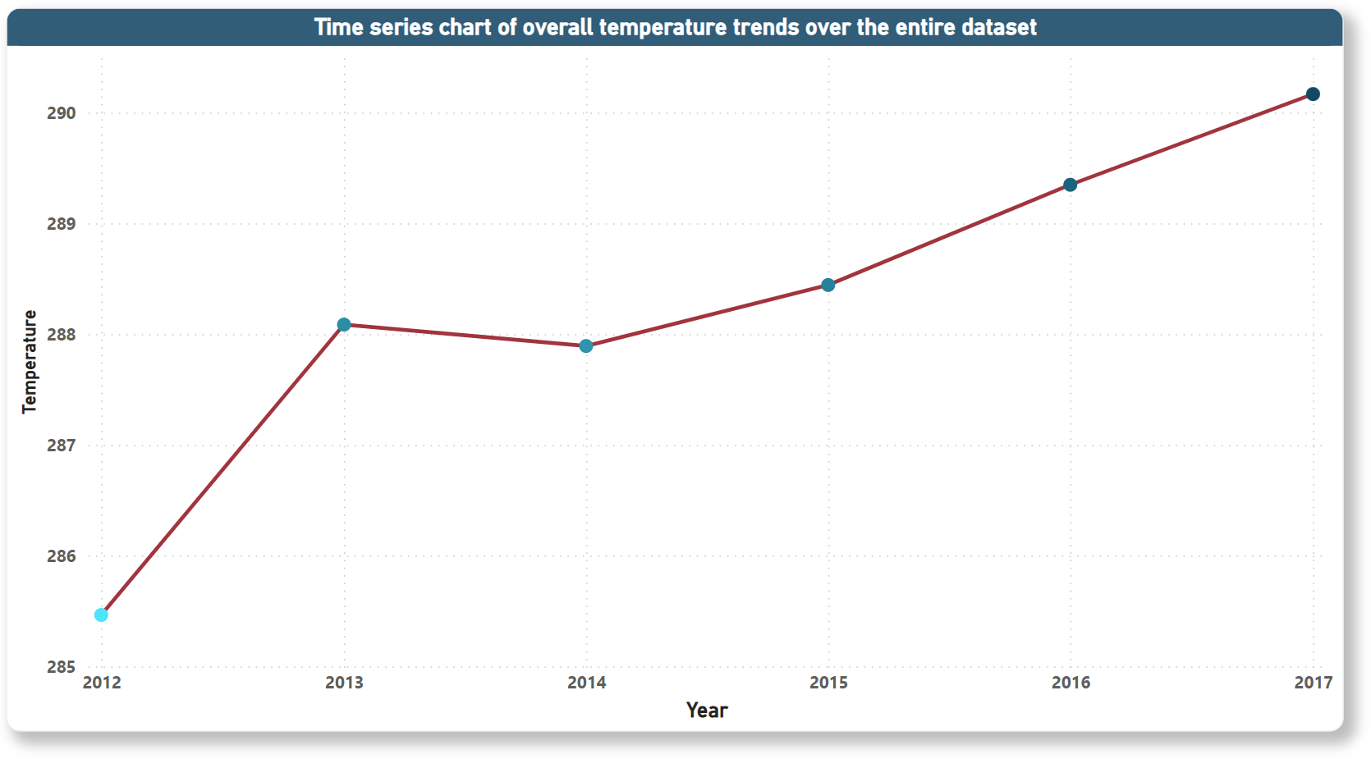
7. Create a time-series line chart in Power BI to show the overall temperature trends over the entire dataset.
Created a time-series line chart to show the overall temperature trends over the entire dataset, means it showing the trends for overall cities.

Slide 18
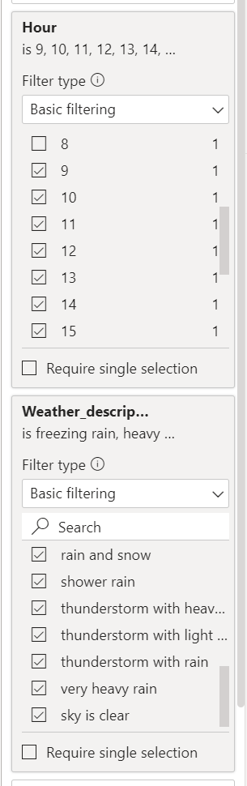
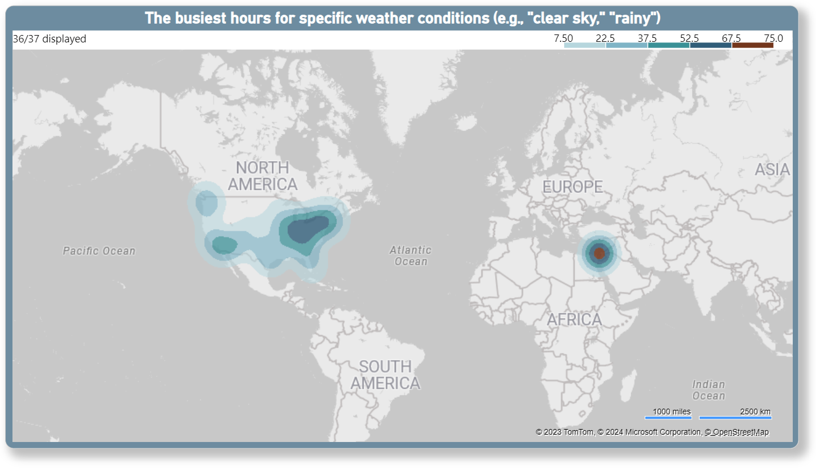
8. Can you create a heatmap in Power BI to visualize the busiest hours for specific weather conditions (e.g., "clear sky," "rainy")?
Created a heatmap to visualize the busiest hours (office hours 9 am-5 pm) for specific weather conditions (e.g., "clear sky," "rainy"). Filtered out the hours and those specific weather for a perfect match.

Slide 19
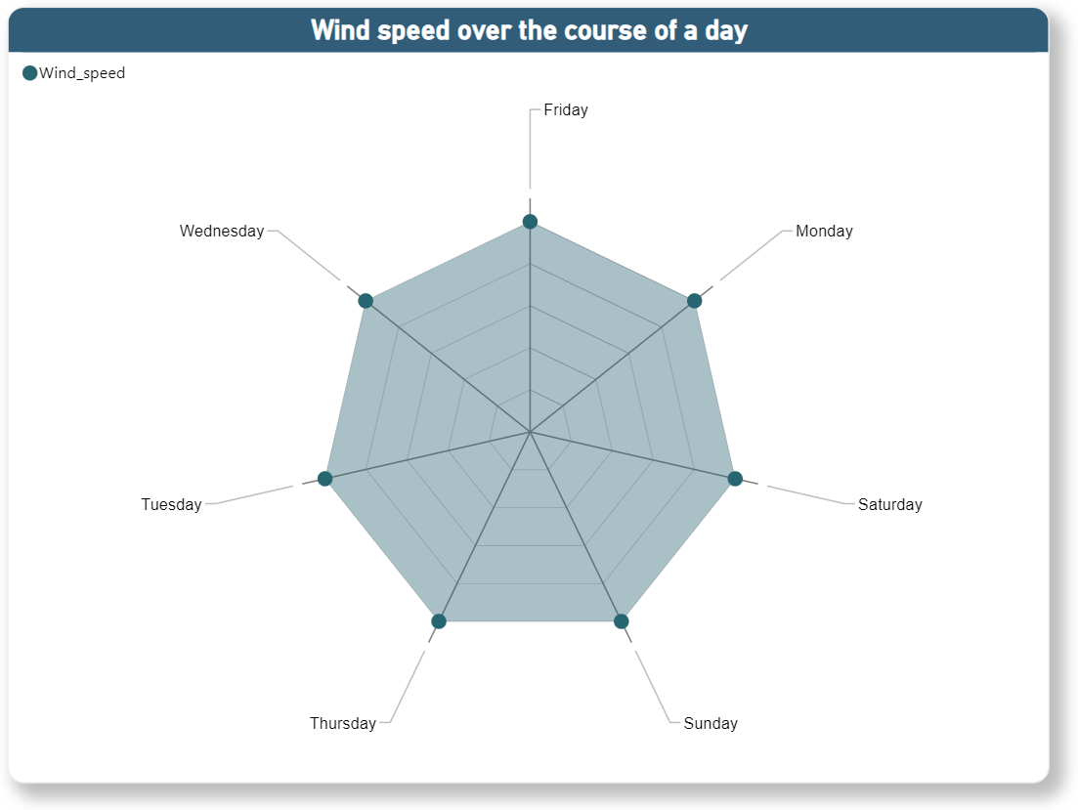
9. How does the wind speed change over the course of a day? Create a radial chart in Power BI to represent this.
Created a radial chart to represent the wind speed change over the course of a day, here I’ve taken the day name to showcase the course of the day.

Slide 20
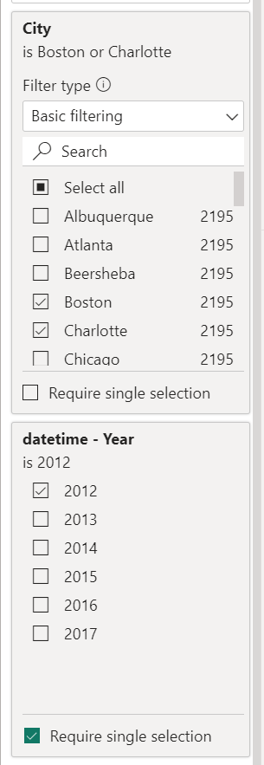
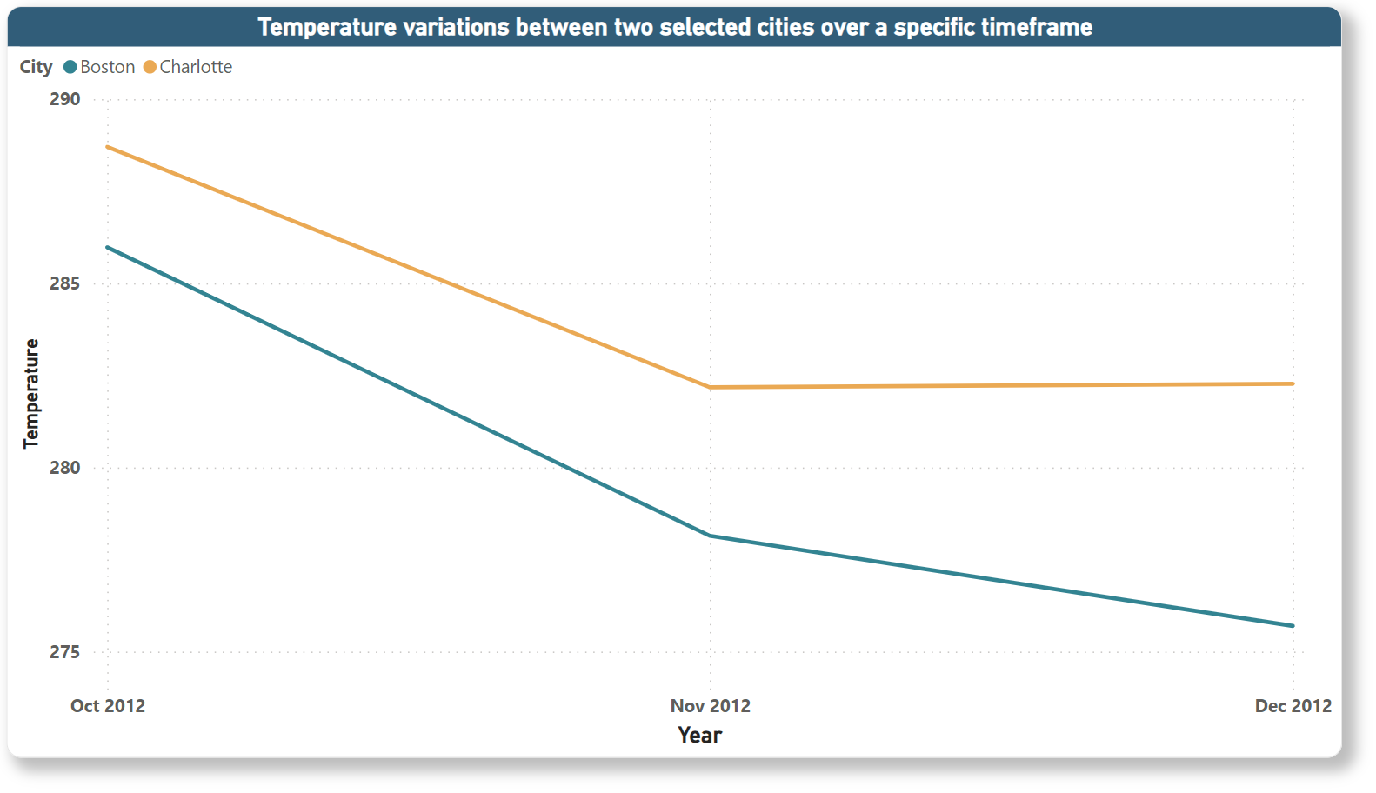
10. Create a Power BI chart comparing the temperature variations between two selected cities over a specific timeframe.
Created a line chart to show the temperature variations between 2 selected cities (Boston & Charlotte) over a specific timeframe (2012). Filtered out the cities and year to showcase the perfect match.

Slide 21
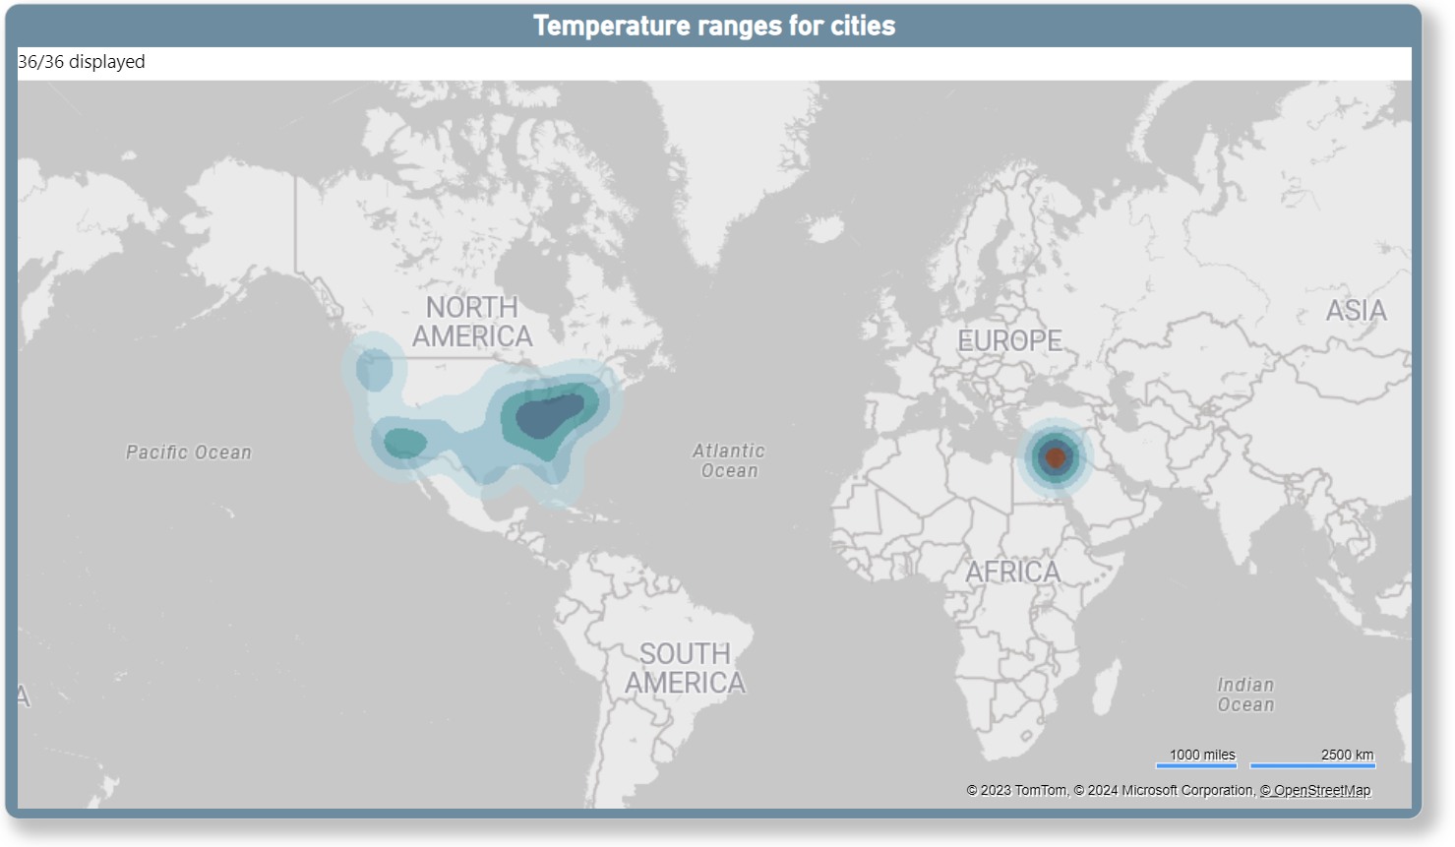
11. Can you build a heatmap in Power BI to show the temperature ranges for cities across different countries?
Created a heatmap to show the temperature ranges for cities across different countries. The deepest brown color showing the maximum temperature, and light green to dark green showing here the lowest to 2nd highest temperature.

Slide 22
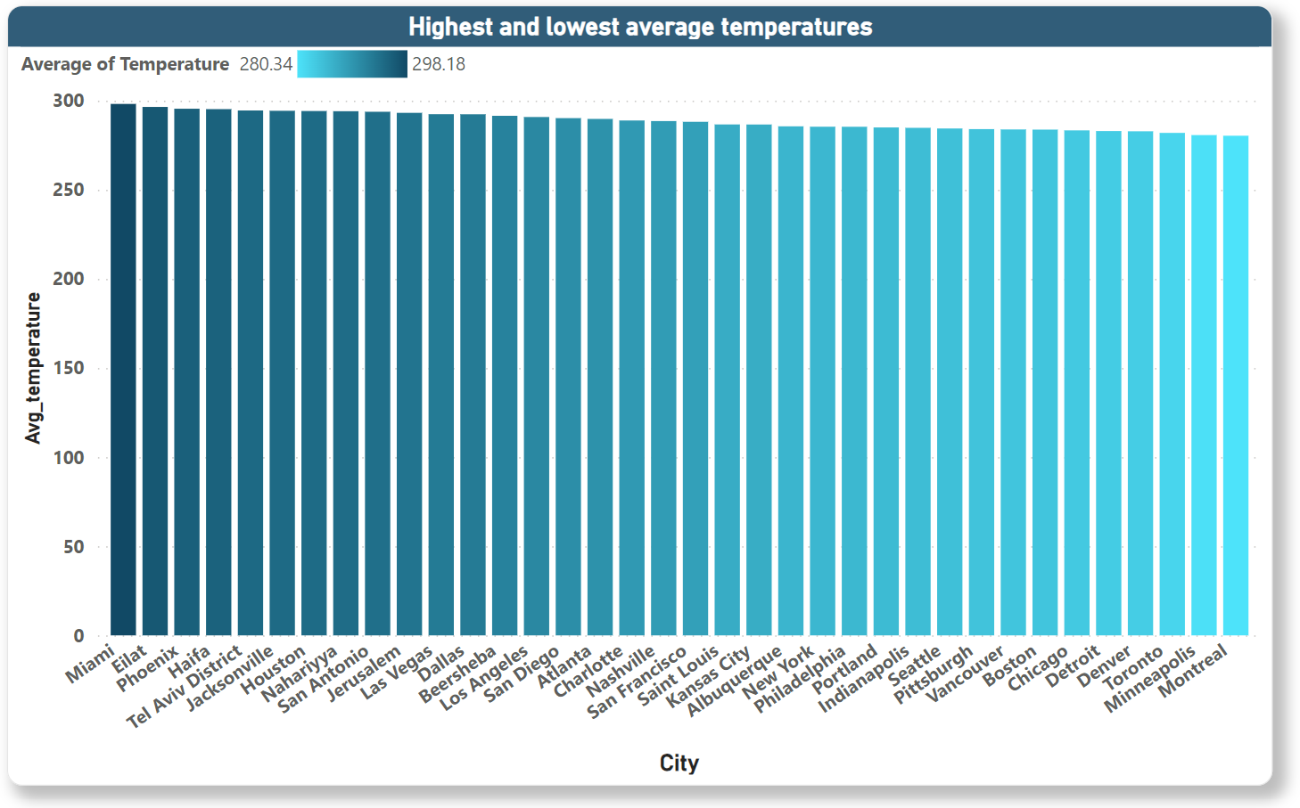
12. Create a bar chart in Power BI to highlight cities with the highest and lowest average temperatures in the dataset.
Created a bar chart to highlight the cities with the highest and lowest temperature in the dataset. The darkest green color referring the highest temperature & the lightest green color referring the lowest temperature.

Slide 23
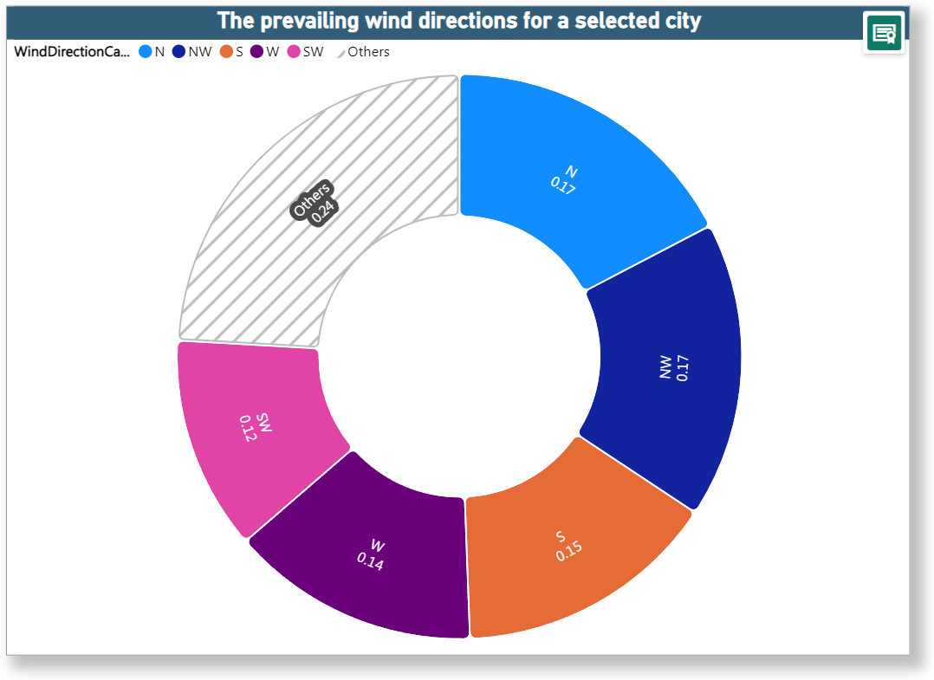
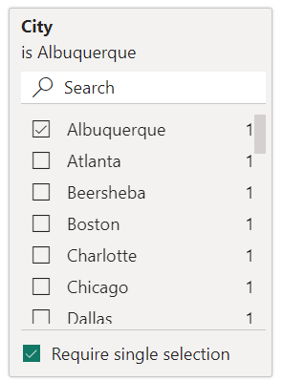
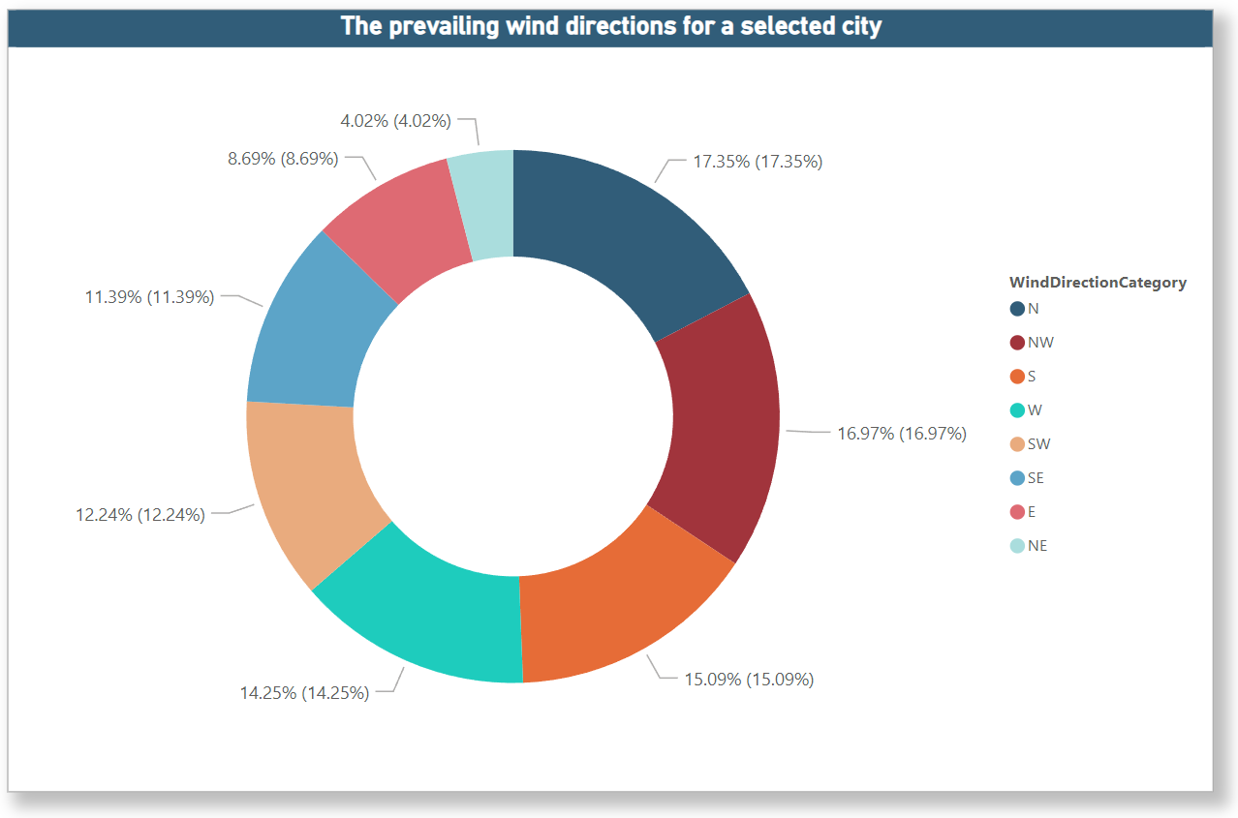
13. Create a wind rose chart in Power BI to visualize the prevailing wind directions for a selected city.
Unfortunately, wind rose chart was not available, so created a rose donut chart (left), also a donut chart (right) to visualize the prevailing wind directions for a selected city, Albuquerque. Filtered out the city in filter section.
Note: we can use any of this chart to visualize this condition.

Slide 24
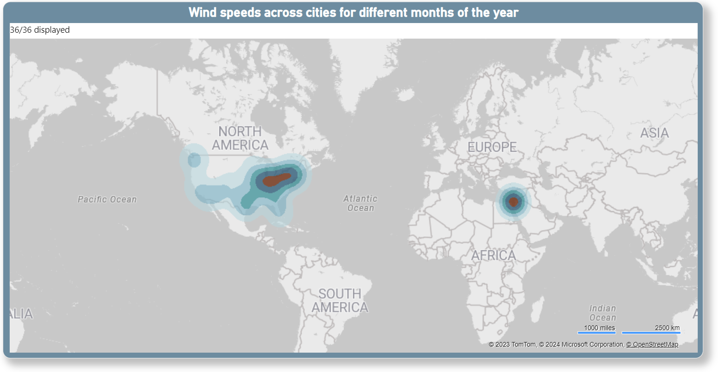
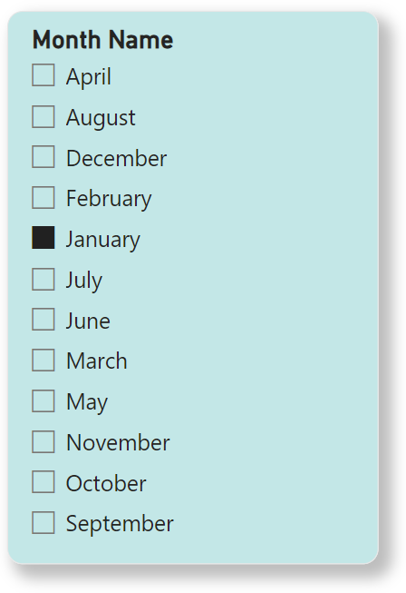
14. Can you generate a Power BI heatmap illustrating the average wind speeds across cities for different months of the year?
Created a heatmap to illustrating the average wind speed across cities for different months of the year. Created a slicer of Month name to show the single month (January). The deepest brown color showing the maximum wind speed, and light green to dark green showing here the lowest to 2nd highest wind speed.

Slide 25
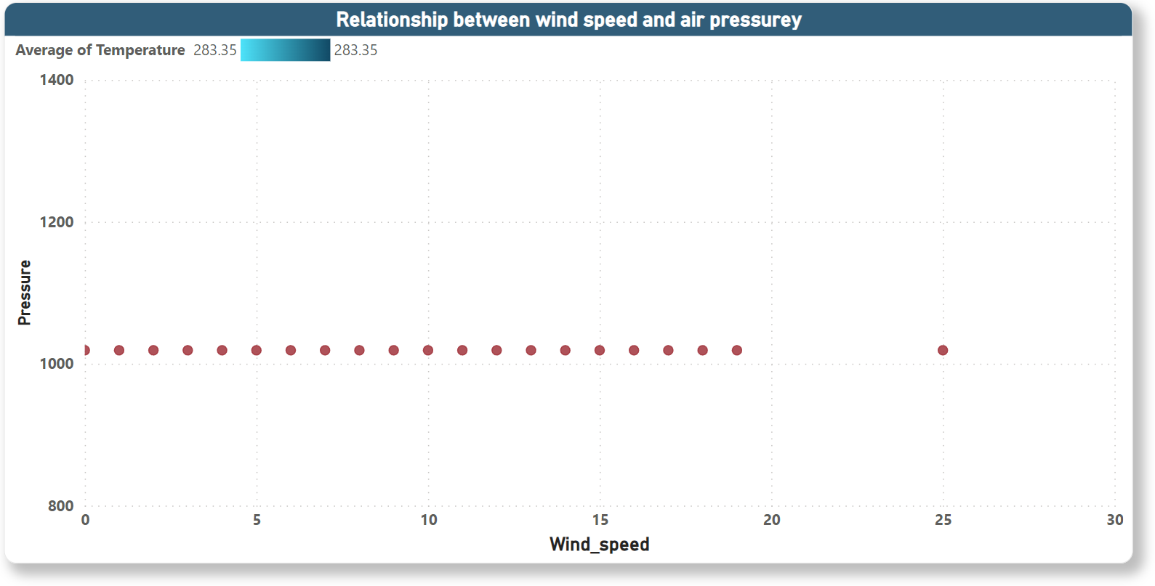
15. Create a Power BI scatter plot to show the relationship between wind speed and air pressure for a specific city.
Created a scatter plot to show the relationship between wind speed and air pressure for a specific city (Chicago). Here I’ve taken the air pressure and not summarized wind speed. Created a slicer to show a specific city.

Slide 26
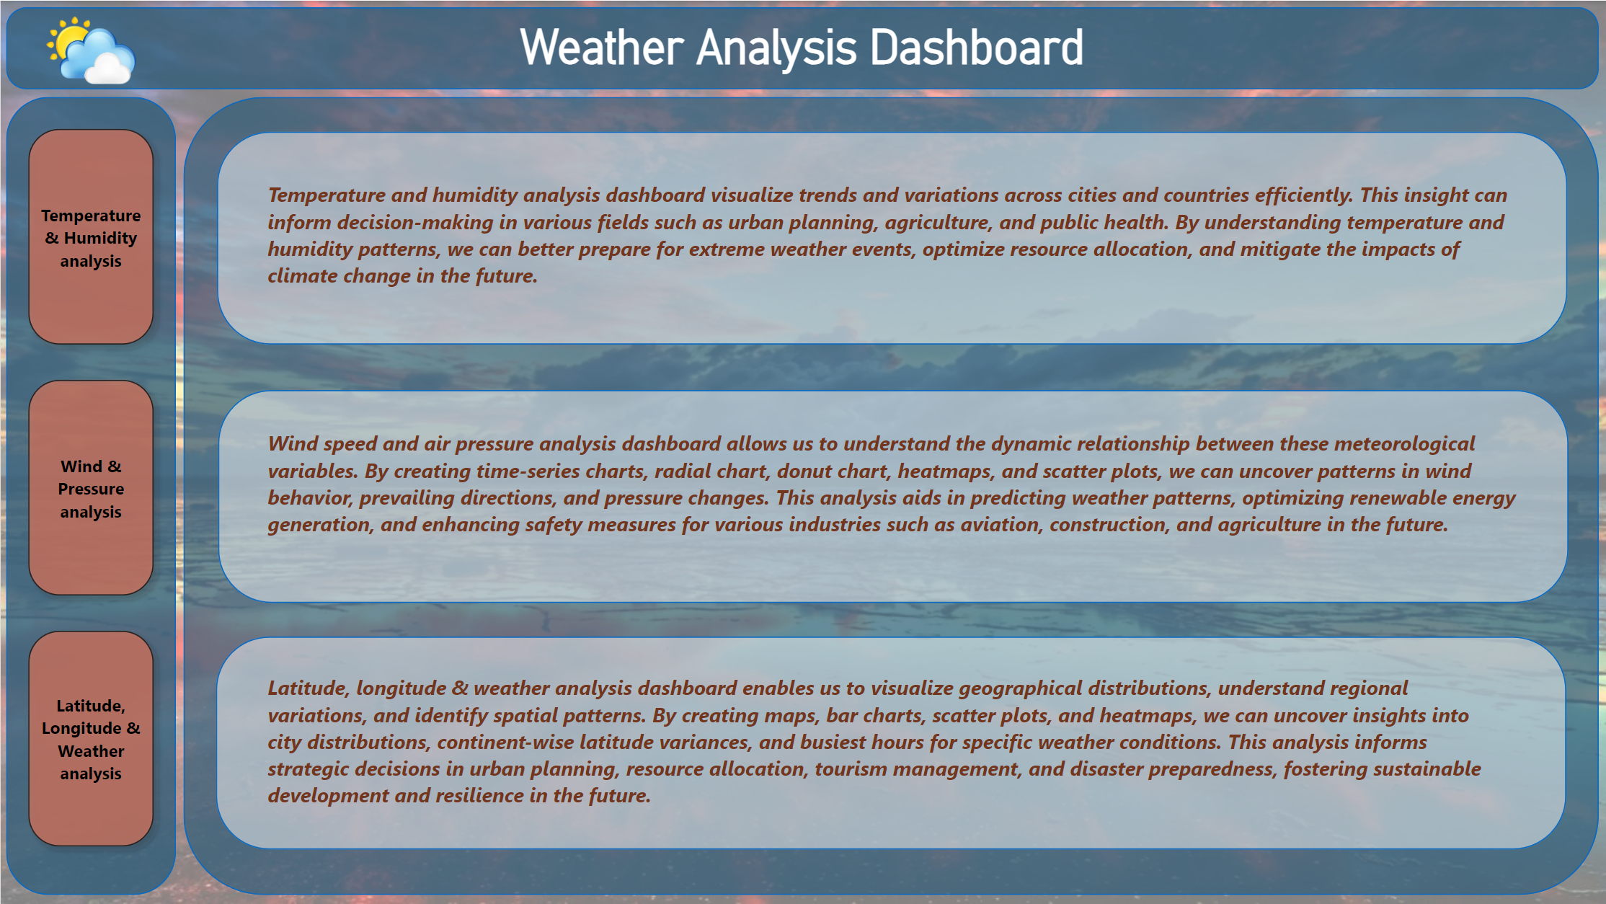
Weather Analysis Dashboard

Slide 27
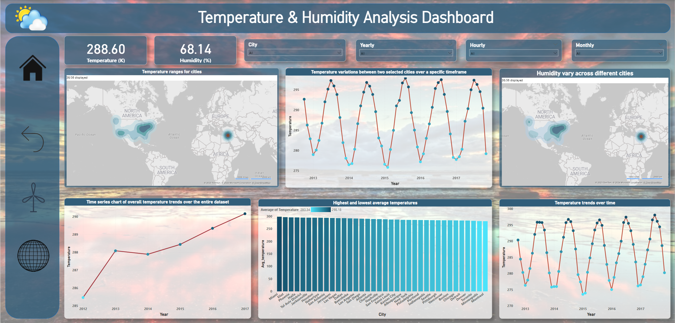
Temperature & Humidity Analysis Dashboard

Slide 28
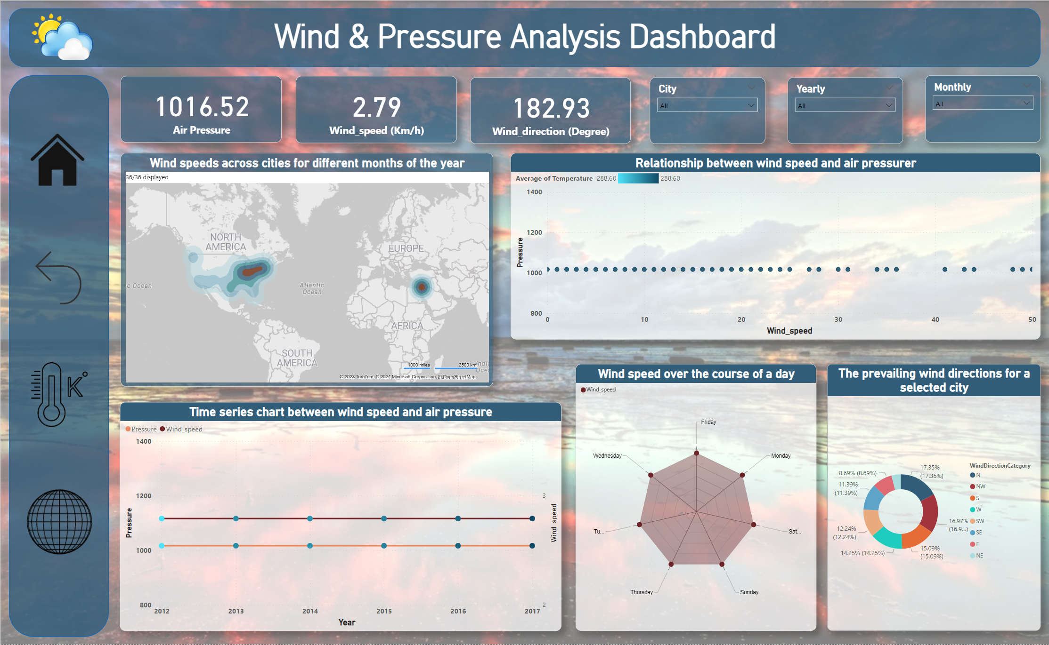
Wind & Pressure Analysis Dashboard

Slide 29
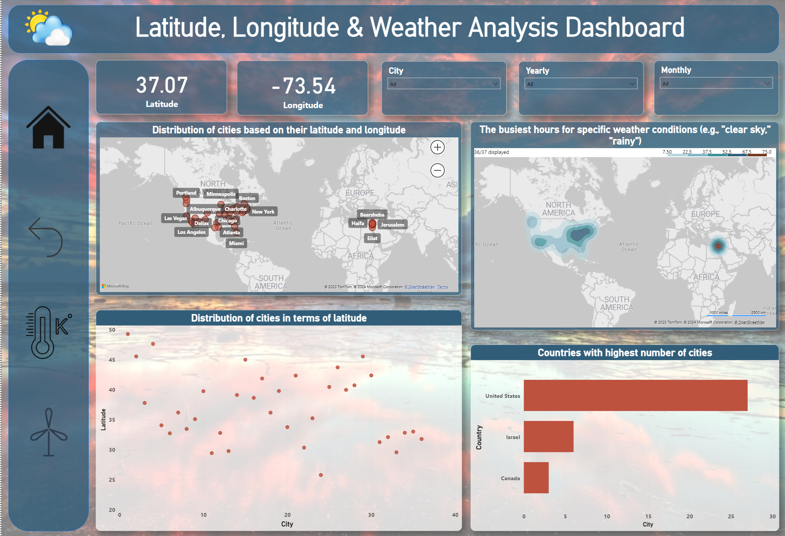
Latitude, Longitude & Weather Analysis Dashboard

Slide 30

Understanding & Solving EDA questions
To gain a comprehensive understanding of the dataset, I delved into 15 exploratory data analysis (EDA) questions. Let's explore them thoroughly.

Slide 31
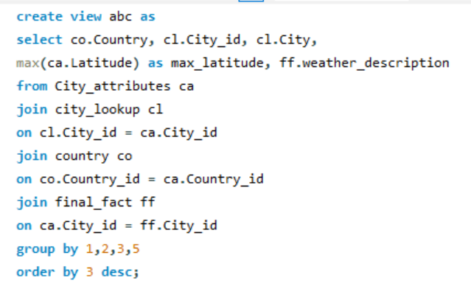
1. Are there any countries with cities located at extreme latitudes, and how might this impact their climate?
Country | City_id | City | max_latitude | weather_description
Canada | 1 | Vancouver | 49.24966 | mist
Canada | 1 | Vancouver | 49.24966 | broken clouds
Canada | 1 | Vancouver | 49.24966 | sky is clear
Canada | 1 | Vancouver | 49.24966 | light rain
Canada | 1 | Vancouver | 49.24966 | few clouds
Canada | 1 | Vancouver | 49.24966 | fog
Canada | 1 | Vancouver | 49.24966 | overcast clouds
Canada | 1 | Vancouver | 49.24966 | light intensity shower rain
A latitude above 60 degrees North is often considered to be an extreme northern latitude or Extreme maximum latitude. Some cities like, Iqaluit, Canada (63.7°N), Troms, Norway (69.6°N), Yakutsk, Russia (62.0°N), Fairbanks, Alaska ( 64.8° N) situated in extreme North hemisphere, These cities witnessing a polar night, extreme cold snaps, mostly snowfall, wind speeds can reach more than 40 km/h, more than avg -40 degree K in winter.
A latitude below -60 degrees South is considered an extreme southern latitude or Extreme minimum latitude. Cities like, Ushuaia, Argentina (54.8°S), McMurdo Station, Antarctica (77.8°S) situated in extreme South hemisphere. Witness of wind speed 100 km/h, avg -28 degree c temperature through the year.

Slide 32
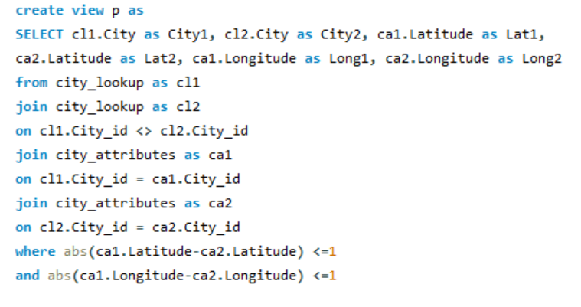
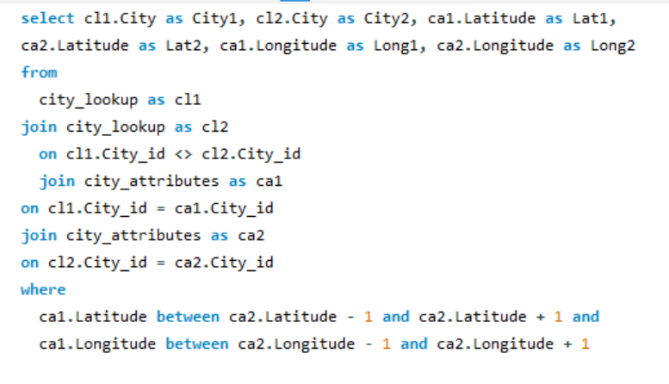
2. Can you identify any clusters of cities with similar latitude and longitude values? What factors might explain these clusters?
City1 | City2 | Lat1 | Lat2 | Long1 | Long2
Tel Aviv District | Beersheba | 32.083328 | 31.25181 | 34.799999 | 34.791302
Jerusalem | Beersheba | 31.769039 | 31.25181 | 35.216331 | 34.791302
Beersheba | Tel Aviv District | 31.25181 | 32.083328 | 34.791302 | 34.799999
Haifa | Tel Aviv District | 32.815559 | 32.083328 | 34.98917 | 34.799999
Nahariyya | Tel Aviv District | 33.005859 | 32.083328 | 35.09409 | 34.799999
Jerusalem | Tel Aviv District | 31.769039 | 32.083328 | 35.216331 | 34.799999
Tel Aviv District | Haifa | 32.083328 | 32.815559 | 34.799999 | 34.98917
Nahariyya | Haifa | 33.005859 | 32.815559 | 35.09409 | 34.98917
Tel Aviv District | Nahariyya | 32.083328 | 33.005859 | 34.799999 | 35.09409
Haifa | Nahariyya | 32.815559 | 33.005859 | 34.98917 | 35.09409
Beersheba | Jerusalem | 31.25181 | 31.769039 | 34.791302 | 35.216331
Tel Aviv District | Jerusalem | 32.083328 | 31.769039 | 34.799999 | 35.216331
Noticeable facts –
Cities at similar latitudes often experience similar climate patterns, which can influence their development and infrastructure.
Similar economic activities, such as agriculture, industry, or technology, may attract cities to specific regions.
Proximity to major transportation routes, such as highways, railways, or airports, can influence the development and connectivity of cities.
Cultural and political factors can play a role in the development and clustering of cities.
These cities has Latitude and Longitude within 1 degree of distance. Distance between 1-2 degree can be considered approximately similar Latitude and Longitude. So, we can say these cities has similar Latitude and Longitude values. To fetch these cities we can use any of these above SQL queries.

Slide 33
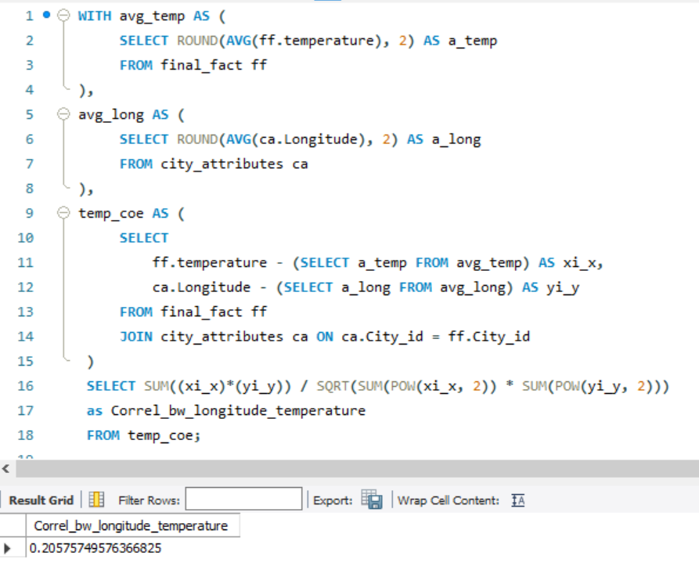
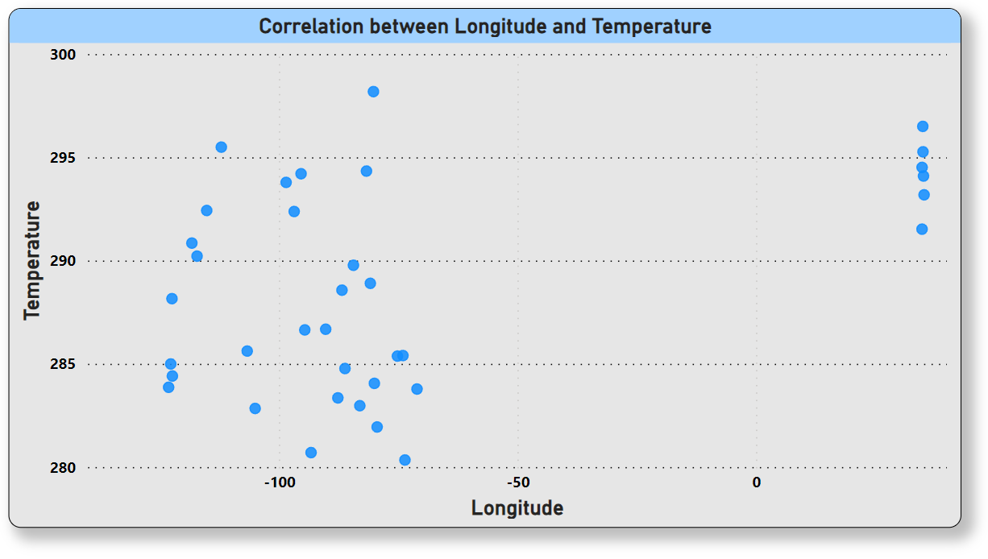
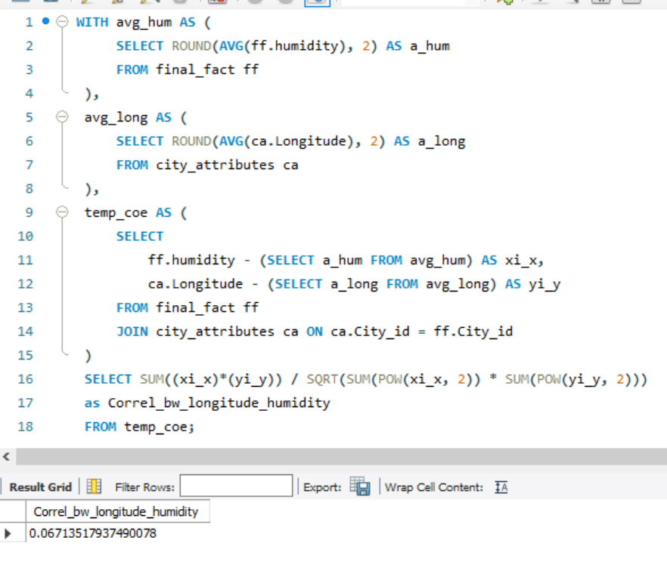
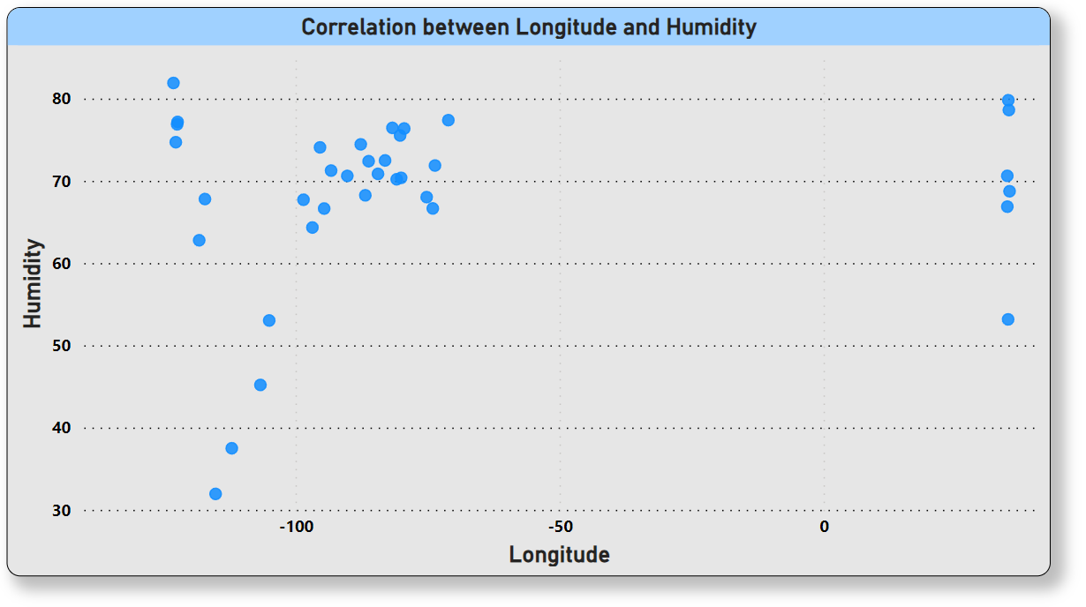
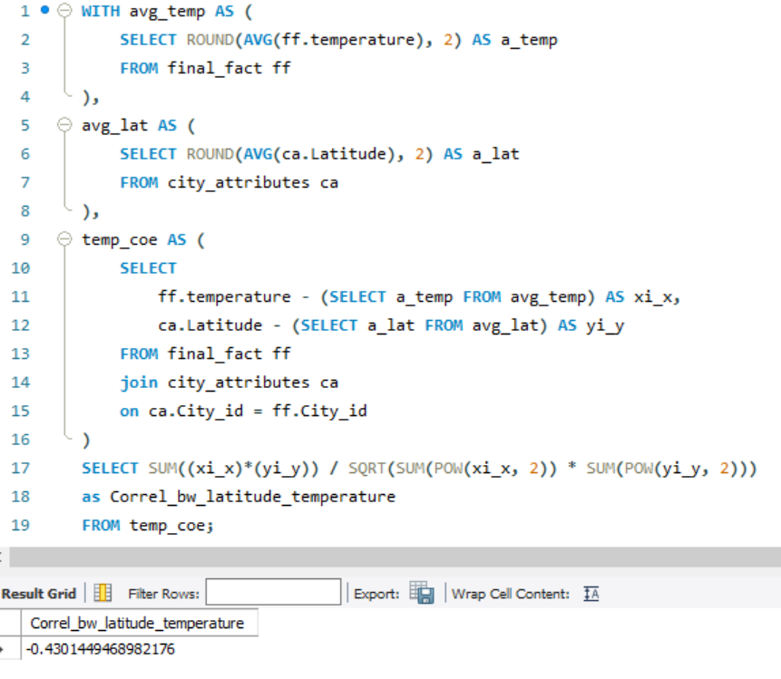
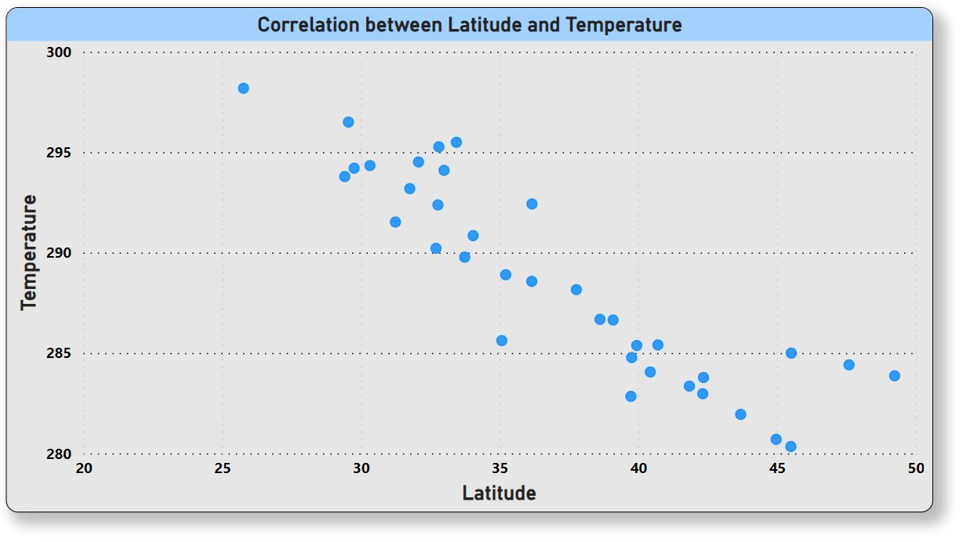
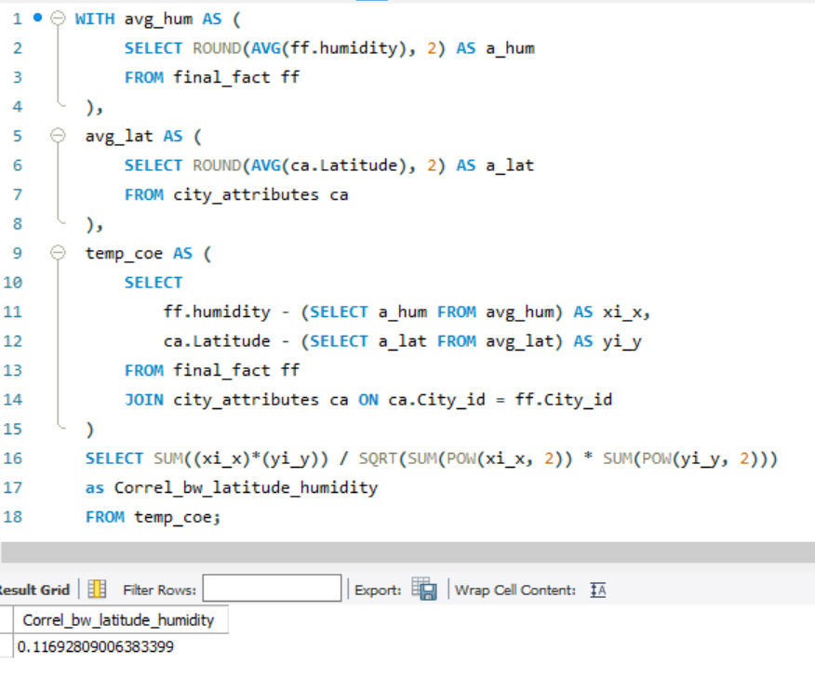
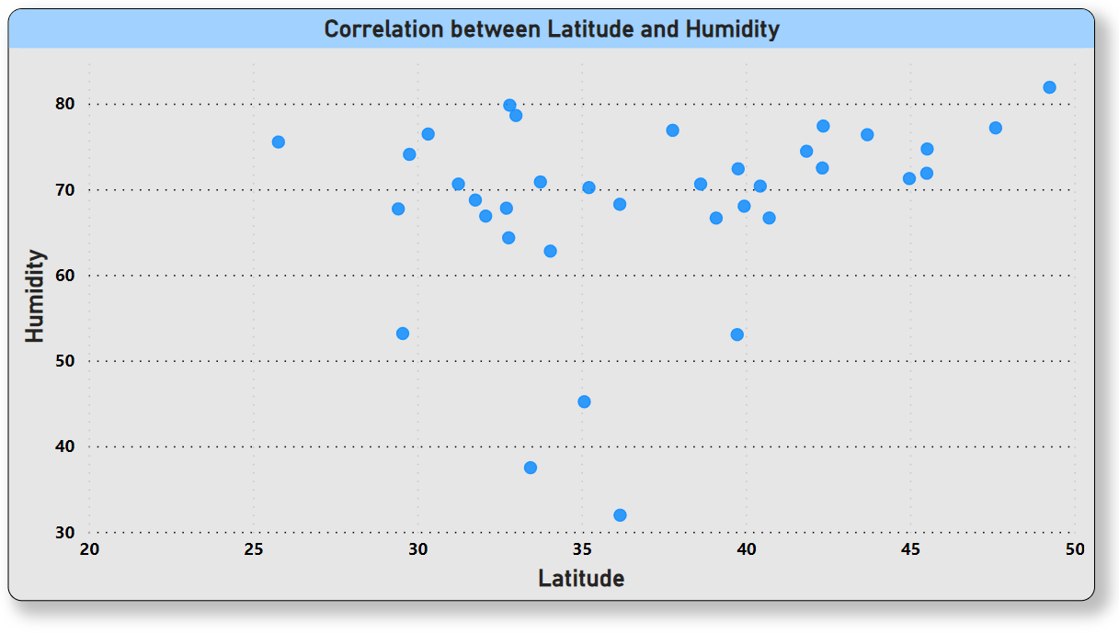
3. Are there any correlations between a city's geographical location (latitude and longitude) and its weather attributes, such as temperature or humidity?
(-0.4301449) indicates a moderate negative correlation b/w Latitude & Temperature.
(0.20575749) indicates a weak positive correlation b/w Longitude & Temperature.
(0.11692809) indicates a very weak positive correlation b/w Latitude & Humidity.
(0.067135179) also indicates a very weak positive correlation b/w Longitude & Humidity.
Correlation b/w Latitude & Temperature |  |  |  | -0.4301449
Correlation b/w Longitude & Temperature |  |  |  | 0.20575749
Correlation b/w Latitude & Humidity |  |  |  | 0.11692809
Correlation b/w Longitude & Humidity |  |  |  | 0.067135179

Slide 34
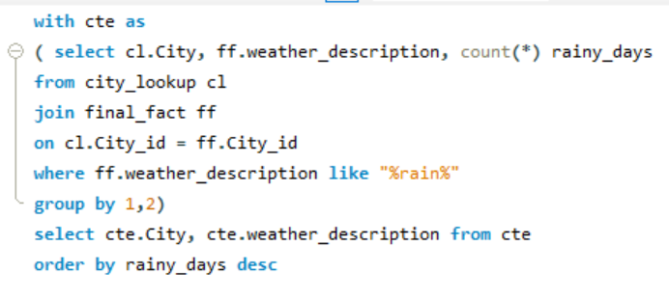
4. Identify the top three cities with the most frequent occurrence of rainy weather based on weather descriptions. What are the seasonal patterns?
City | weather_description
Portland | light rain
Seattle | light rain
Miami | light rain
Vancouver | light rain
Philadelphia | light rain
Boston | light rain
Pittsburgh | light rain
Houston | light rain
Montreal | light rain
New York | light rain
Rainy weathers for top 3 cities
freezing rain
heavy intensity rain
heavy intensity shower rain
light intensity drizzle rain
light intensity shower rain
light rain
light rain and snow
moderate rain
proximity moderate rain
proximity shower rain
proximity thunderstorm with rain
ragged shower rain
rain and snow
shower rain
thunderstorm with heavy rain
thunderstorm with light rain
thunderstorm with rain
very heavy rain
Top 3 Cities | Max count of rainy weather
Toronto | 15
Montreal | 14
Vancouver | 13
Toronto, Montreal & Vancouver are the top 3 cities with the most frequent occurrence of rainy weather based on weather description.
Spring (March-May) and Fall (September-November) average around 75-85mm of rain per month in Toronto.
Spring (March-May) sees the most rain, averaging around 75-90mm per month in Montreal.
Winter (December-February) brings the most rain, averaging around 150-200mm per month in Vancouver.

Slide 35
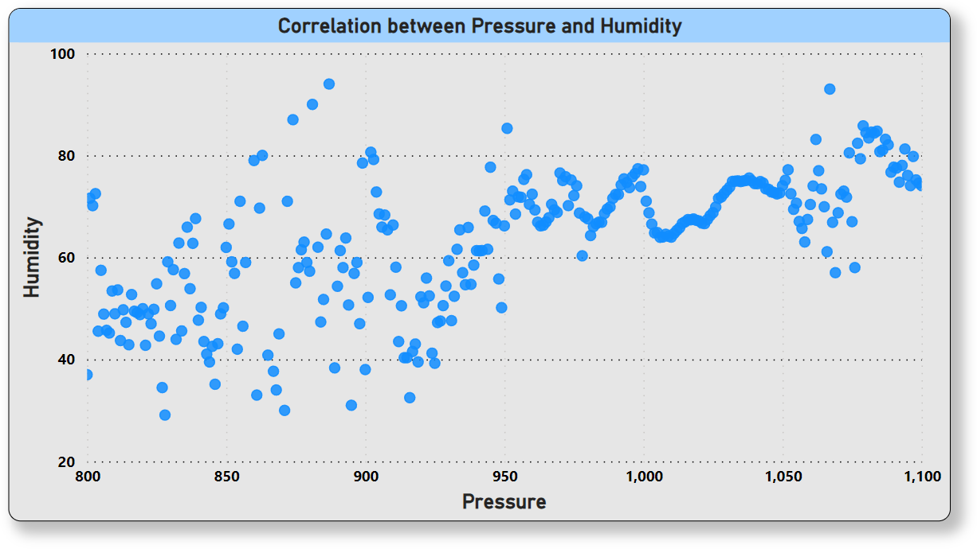
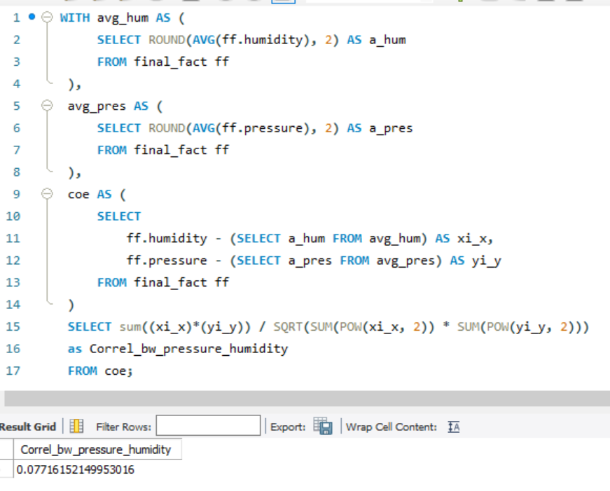
5. Is there a correlation between humidity levels and air pressure? How might this relationship affect weather conditions?
avg_humidity | avg_pressure | weather_description
87.35 | 1015.28 | mist
66.18 | 1017.21 | broken clouds
61.17 | 1015.85 | sky is clear
80.27 | 1017.44 | light rain
62.46 | 1017.09 | few clouds
90.46 | 1016.38 | fog
73.33 | 1015.88 | overcast clouds
78.6 | 1011.91 | light intensity shower rain
85.93 | 1019.6 | moderate rain
A correlation of 0.077 between humidity levels and air pressure is a relatively weak positive relationship.
Weak correlation means humidity level and air pressure do not strongly drive each other. Other factors have a bigger direct impact on weather.
With higher pressure, subsiding air warms and loses relative humidity. Lower pressure allows rising, cooling air to retain more moisture.
Humidity and pressure may correlate more strongly on short time scales, but other dynamics dominate over long periods.
Higher pressure typically brings more settled, stable weather. Lower pressure indicates storm systems are more likely.

Slide 36
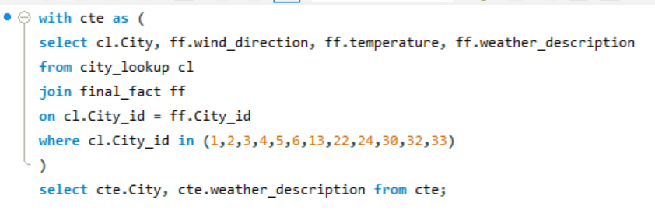
6. Explore the impact of wind direction on temperature for coastal cities. Are there noticeable patterns?
City ID | Coastal Cities
1 | Vancouver
2 | Portland
3 | San Francisco
4 | Seattle
5 | Los Angeles
6 | San Diego
13 | Houston
22 | Jacksonville
24 | Miami
30 | Boston
32 | Tel Aviv District
33 | Eilat
Coastal City | weather_description
Vancouver | mist
Vancouver | broken clouds
Vancouver | broken clouds
Vancouver | broken clouds
Vancouver | broken clouds
Vancouver | broken clouds
Vancouver | broken clouds
Vancouver | broken clouds
Vancouver | broken clouds
Vancouver | broken clouds
The impact of wind direction on temperature for coastal cities can exhibit several noticeable patterns:
Onshore winds (blowing from the ocean towards the land):
Typically bring cooler air over land, especially during summer. This is because ocean water generally has a lower temperature than the land during the warm season.
Can bring warmer air during winter if the ocean water is warmer than the land.
Offshore winds (blowing from the land towards the ocean):
Typically bring warmer air over land, especially during summer. This is because the land heats up faster than the ocean during the warm season.
Can bring cooler air during winter if the land is colder than the ocean water.

Slide 37
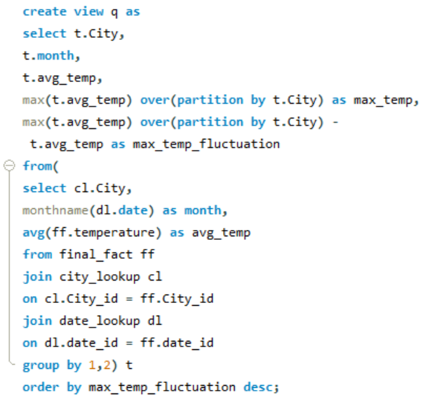
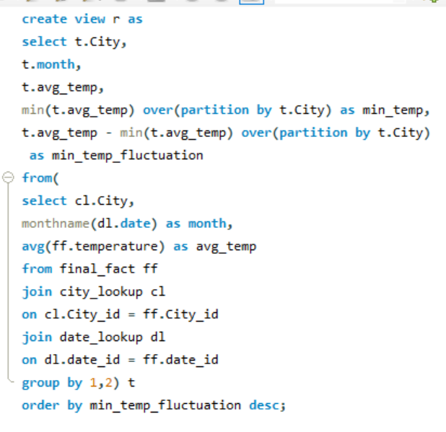
7. Are there specific months when cities experience significant temperature fluctuations? What might explain these variations?
City | month | avg_temp | max_temp | max_temp_fluctuation
Minneapolis | January | 264.1889103 | 295.3295214 | 31.14061107
Minneapolis | February | 265.1646816 | 295.3295214 | 30.16483977
Montreal | February | 264.8355044 | 294.3005872 | 29.46508282
Montreal | January | 265.6189056 | 294.3005872 | 28.68168168
Minneapolis | December | 267.2912517 | 295.3295214 | 28.03826963
Detroit | February | 268.8679292 | 295.6821602 | 26.81423106
Las Vegas | December | 279.7797912 | 306.2685698 | 26.48877857
Toronto | February | 268.1386153 | 294.5796928 | 26.44107754
From this query, I'm getting the average temperature of per month in last 5 years, and also what is the maximum average temperature and the minimum average temperature. By this, we can understand what can be the temperature fluctuations in each month. Cities can experience significant temperature fluctuations due to various factors, including:
Seasonal changes
Continental vs. maritime climates
Urban heat island effect
Synoptic weather patterns
Local factors
City | month | avg_temp | min_temp | min_temp_fluctuation
Minneapolis | July | 295.3295214 | 264.1889103 | 31.14061107
Minneapolis | August | 293.9916383 | 264.1889103 | 29.80272804
Montreal | July | 294.3005872 | 264.8355044 | 29.46508282
Minneapolis | June | 293.3294662 | 264.1889103 | 29.14055591
Montreal | August | 293.0499331 | 264.8355044 | 28.21442863
Detroit | July | 295.6821602 | 268.8679292 | 26.81423106
Minneapolis | September | 290.9390717 | 264.1889103 | 26.75016145
Las Vegas | July | 306.2685698 | 279.7797912 | 26.48877857

Slide 38
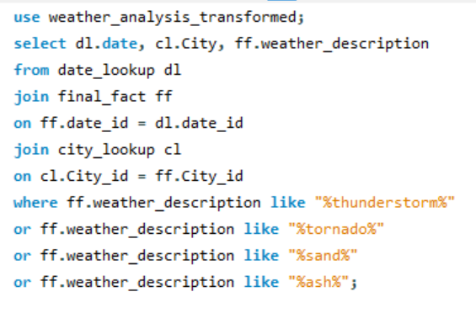
8. Identify periods of extreme weather events, such as storms or heatwaves, by analyzing the time-based data. What patterns emerge?
Top Periods | Count of weather_description
2017 | 3238
2016 | 2382
2015 | 2033
2014 | 1087
2013 | 1975
2012 | 153
As we can see the period of 2017 was the year of extreme weather events, such as storms or heatwaves, by analyzing the time-based data , also in table format I’ve shown the weather patterns emerge in those periods.
Weather patterns
heavy thunderstorm
proximity sand/dust whirls
proximity thunderstorm
proximity thunderstorm with drizzle
proximity thunderstorm with rain
ragged thunderstorm
sand
sand/dust whirls
thunderstorm
thunderstorm with drizzle
thunderstorm with heavy drizzle
thunderstorm with heavy rain
thunderstorm with light drizzle
thunderstorm with light rain
thunderstorm with rain
tornado
volcanic ash
date | City | weather_description
2012-10-07 | San Francisco | proximity thunderstorm
2012-10-09 | San Francisco | thunderstorm
2012-10-19 | San Francisco | thunderstorm with heavy rain
2012-12-11 | San Francisco | thunderstorm
2012-12-11 | San Francisco | thunderstorm with heavy rain
2012-10-12 | Los Angeles | thunderstorm with rain
2012-10-12 | Los Angeles | thunderstorm
2012-10-12 | Las Vegas | proximity thunderstorm

Slide 39
9. Are there any notable differences in temperature trends between northern and southern hemisphere cities over the year? How do they relate to seasons?
In this Weather_analysis dataset we have total 36 Cities, which all are coming under Northern hemisphere, unfortunately we don’t have any cities under Southern hemisphere in this data.
But, there are many significant differences in temperature trends between northern and southern hemisphere cities over the year, due to the Earth's tilt on its axis and its revolution around the sun.
Northern Hemisphere:
Summer | June-August
Autumn | September-November
Winter | December-February
Spring | March-May
Longer days and more direct sunlight lead to warmer temperatures. The higher the latitude, the shorter the days and cooler the temperatures become.
Southern Hemisphere:
Summer | December-February
Autumn | March-May
Winter | June-August
Spring | September-November
Opposite to the north, this is the hottest time with longer days and more direct sunlight. Higher latitudes are cooler.

Slide 40
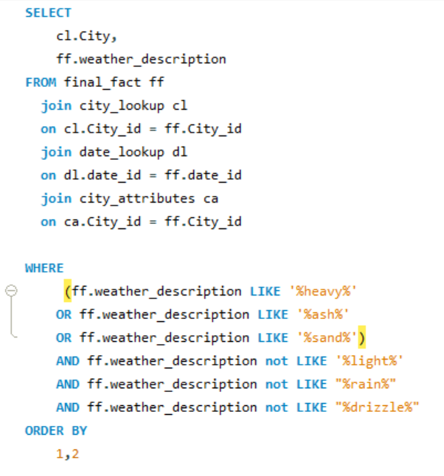
10. What are the consequences of prolonged periods of extreme cold or heat in specific cities? How do residents adapt to such conditions?
Consequences of Extreme Cold:
Extreme cold poses health risks including hypothermia, frostbite, and heart attacks, while also causing infrastructure challenges like frozen pipes and transportation disruptions. Additionally, it leads to economic losses, energy consumption spikes, and exacerbates social and mental health issues.
Adaptation Strategies to Extreme Cold:
Residents prepare with layered clothing and snowmobiles, but prolonged cold strains infrastructure and health. Adequate insulation, snow removal, and emergency kits are vital for safety and comfort. Cities prioritize vulnerable populations' access to shelter and healthcare during extreme events.
Consequences of Extreme Heat:
Extreme heat poses health risks like heat-related illnesses and strains energy resources, leading to power outages and infrastructure damage. Prolonged heatwaves affect crops, water supply, and urban areas, impacting productivity and increasing costs.
Adaptation Strategies to Extreme Heat:
Cities establish cooling centers for relief from high temperatures and promote water conservation during heatwaves. Increasing shade and green spaces in urban areas help cool environments, while public awareness campaigns educate on heat risks and safety measures. Additionally, ensuring vulnerable populations access shelter, cooling centers, and healthcare during extreme events is prioritized.
City | weather_description
Albuquerque | heavy snow
Albuquerque | heavy snow
Albuquerque | heavy snow
Albuquerque | heavy snow
Albuquerque | heavy snow
Albuquerque | heavy snow
Albuquerque | heavy snow
Albuquerque | heavy snow
Weather events
heavy shower snow
heavy snow
heavy thunderstorm
proximity sand/dust whirls
sand
sand/dust whirls
volcanic ash

Slide 41
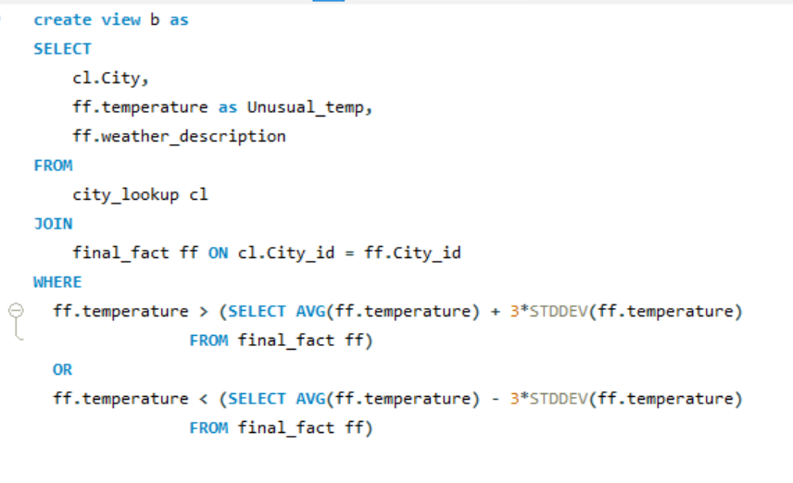
11. Investigate whether temperature anomalies (unusual deviations from the norm) coincide with certain events or environmental factors in specific cities.
Weather_events
broken clouds
few clouds
fog
haze
heavy shower snow
heavy snow
light intensity drizzle
light rain
light shower snow
light snow
mist
moderate rain
overcast clouds
proximity shower rain
scattered clouds
sky is clear
snow
very heavy rain
City | Average of Unusual_temp | Count of weather_description
Tel Aviv District | 320.93 | 1
Haifa | 320.375 | 2
Phoenix | 320.3535714 | 14
Eilat | 320.15 | 2
Nashville | 256.8724722 | 12
Charlotte | 256.5072 | 5
Albuquerque | 256.163 | 4
Saint Louis | 255.9150594 | 101
Philadelphia | 255.601952 | 59
Chicago | 255.5147911 | 596
Kansas City | 255.4126315 | 168
Boston | 255.3898604 | 61
Pittsburgh | 255.353999 | 200
Toronto | 255.2935548 | 441
Denver | 255.2381346 | 389
New York | 255.2303855 | 72
Indianapolis | 254.7733258 | 317
Detroit | 254.4457814 | 443
Montreal | 254.1798454 | 1500
Minneapolis | 253.2845196 | 2260
Vancouver | 249.8021122 | 4
City | Unusual_temp | weather_description
Vancouver | 245.15 | broken clouds
Vancouver | 248.9412006 | broken clouds
Vancouver | 254.9672484 | broken clouds
Vancouver | 250.15 | light snow
Phoenix | 319.83 | scattered clouds
Phoenix | 319.71 | scattered clouds
Phoenix | 319.8 | sky is clear
Phoenix | 320.89 | sky is clear
Phoenix | 321.22 | sky is clear
The comfortable or ideal temperature for a city around the year between 275-295 degree K. In this 12 cities from Weather_analysis dataset has the average anomalies temperature, which is less than 275K and more than 295K.
And, these are the noticeable certain weather events occur in these temperature

Slide 42
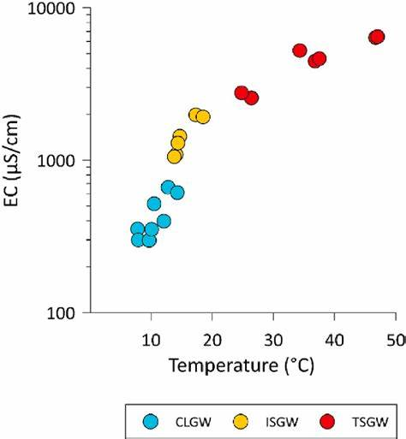
12. Analyze the impact of temperature on energy consumption patterns in cities. Are there noticeable trends or correlations?
Unfortunately, I don't have any real time data about the impact of temperature on energy consumption patterns in cities.
Though, Let’s try to analyze the impact of temperature on energy consumption patterns in cities.
Temperature & City Energy Use:
Summer: Higher temps -> More AC -> Higher electricity use (warmer climates, denser cities hit harder).
Winter: Colder temps -> More heating -> Higher consumption of gas/electricity/fuel (varies by infrastructure).
Mild seasons: Less heating/cooling -> Lower overall energy use (potentially).
Building efficiency: Better insulation/systems = less impact from temp changes.
Urban design: Walkable, mixed-use cities encourage walking/cycling -> less transport energy use.
Socioeconomic factors: Low-income communities more vulnerable to energy price fluctuations.
Renewable energy: More renewables = less susceptibility to price hikes during peak demand.
Trends: Strong correlation between temp & electricity use, expected to increase with climate change.
Mitigation strategies: Cities promoting energy efficiency, renewable energy, & smart grids.

Slide 43
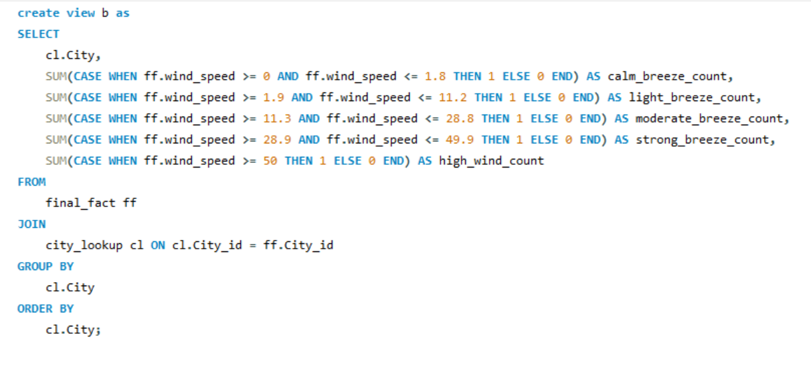
13. How do specific wind patterns impact air quality and pollution dispersion in urban areas? Analyze wind direction data for insights.
City | calm_breeze_count | light_breeze_count | moderate_breeze_count | strong_breeze_count | high_wind_count
Albuquerque | 14904 | 29977 | 368 | 0 | 0
Atlanta | 17069 | 28163 | 20 | 0 | 0
Beersheba | 22616 | 21835 | 9 | 0 | 0
Boston | 8843 | 36256 | 153 | 0 | 0
Charlotte | 14941 | 30302 | 8 | 0 | 0
a) Calm breeze: 0-1.8 km/h (or 0-1 knots)
b) Light breeze: 1.9-11.2 km/h (or 2-6 knots)
c) Moderate breeze: 11.3-28.8 km/h (or 7-16 knots)
d) Strong breeze: 28.9-49.9 km/h (or 17-27 knots)
e) High wind: 50 km/h or higher (or 28 knots or higher)
Note: Well, I will prefer to analyze the wind_speed to get the insights for air quality & pollution instead of Wind_direction
The higher wind speed go, result in very low pollution levels and excellent air quality. Exposure to harmful pollutants is minimal, leading to improved respiratory health and reduced health risks for the population.
The lighter wind speed go, it helps disperse pollutants and improve air quality by enhancing ventilation and mixing of the atmosphere. This can reduce local pollution concentrations and mitigate the effects of emissions from traffic, industry, and other sources.

Slide 44
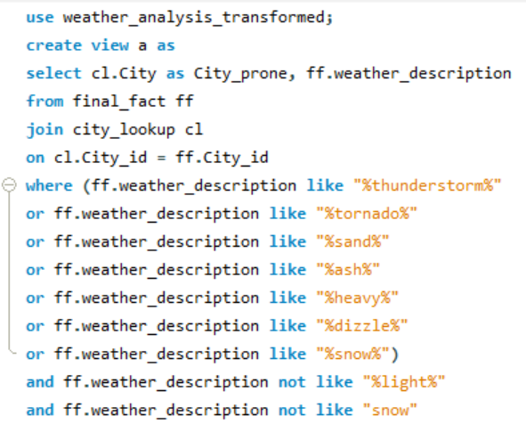
14. Identify cities prone to strong winds and the potential consequences, such as increased risk of natural disasters or challenges for transportation.
Natural disaster
heavy intensity drizzle
heavy intensity rain
heavy intensity shower rain
heavy shower snow
heavy snow
heavy thunderstorm
proximity sand/dust whirls
proximity thunderstorm
proximity thunderstorm with drizzle
proximity thunderstorm with rain
ragged thunderstorm
rain and snow
sand
sand/dust whirls
shower snow
thunderstorm
thunderstorm with drizzle
thunderstorm with heavy drizzle
thunderstorm with heavy rain
thunderstorm with rain
tornado
very heavy rain
volcanic ash
In all 36 cities are prone area. For these natural disaster, cities are facing so many life challenges and transportation issues.
Strong winds can cause structural damage to buildings, bridges, power lines, and other infrastructure. This can lead to power outages, disruptions in communication, and even building collapses.
Strong winds can increase the severity of tropical cyclones like hurricanes for coastal cities in their path. This brings high winds, storm surge and flooding.
Blizzards and whiteout conditions become more likely in areas prone to cold, icy winds.
Air travel can be disrupted by takeoff and landing restrictions due to crosswinds. Flight delays and cancellations may increase. Also, Takeoff and landing of small aircraft may be prohibited during strong winds due to safety issues.
City_prone | weather_description
Vancouver | heavy intensity rain
Vancouver | heavy intensity rain
Vancouver | heavy snow
Vancouver | heavy snow
Vancouver | heavy snow
Vancouver | heavy snow
Vancouver | heavy snow
Vancouver | heavy snow

Slide 45


15. Explore whether wind speed and direction influence the frequency and severity of weather-related events (e.g., hurricanes, storms) in coastal cities.
Coastal city | Average of wind_direction | Average of wind_speed | StdDev of wind_direction | StdDev of wind_speed | Max of wind_direction | Max of wind_speed | Min of wind_direction | Min of wind_speed | Count of weather_description
Miami | 149.3480519 | 3.22 | 87.85 | 1.82 | 360 | 11 | 0 | 0 | 1155
Jacksonville | 153.944793 | 3.67 | 88.84 | 2.12 | 360 | 14 | 0 | 0 | 797
Houston | 161.6235294 | 3.58 | 92.42 | 2.07 | 360 | 15 | 0 | 0 | 680
San Francisco | 206.538961 | 3.83 | 105.34 | 2.43 | 360 | 13 | 0 | 0 | 308
Boston | 186.4487179 | 3.59 | 84.06 | 2.15 | 350 | 12 | 0 | 0 | 156
Tel Aviv District | 185.8157895 | 4.39 | 91.58 | 3.01 | 360 | 15 | 0 | 0 | 114
Los Angeles | 174.4237288 | 3.14 | 105.75 | 2.12 | 340 | 9 | 0 | 0 | 59
Seattle | 202.7142857 | 3.31 | 80.92 | 1.98 | 359 | 9 | 20 | 1 | 42
Portland | 204 | 2.67 | 105.12 | 1.81 | 330 | 7 | 0 | 0 | 33
San Diego | 217.137931 | 2.66 | 94.50 | 1.80 | 340 | 9 | 0 | 1 | 29
Vancouver | 180.3461538 | 3.96 | 94.88 | 2.09 | 340 | 8 | 0 | 1 | 26
Eilat | 196.7391304 | 3.65 | 143.93 | 1.90 | 360 | 8 | 0 | 0 | 23
City_id | City | Wind_direction | Wind_speed | weather_description | Month_Name
1 | Vancouver | 80 | 7 | thunderstorm with rain | August
1 | Vancouver | 180 | 4 | thunderstorm with light rain | April
1 | Vancouver | 80 | 4 | proximity thunderstorm | July
1 | Vancouver | 0 | 1 | proximity thunderstorm | September
1 | Vancouver | 170 | 8 | thunderstorm with heavy rain | September
1 | Vancouver | 330 | 1 | thunderstorm | September
1 | Vancouver | 173 | 1 | thunderstorm with light rain | April
Weather events(hurricanes, storms)
proximity thunderstorm
proximity thunderstorm with rain
ragged thunderstorm
thunderstorm
thunderstorm with drizzle
thunderstorm with heavy rain
thunderstorm with light drizzle
thunderstorm with light rain
thunderstorm with rain
tornado
Miami has maximum variation in the change of climate and Eilat has minimum variation in the change of climate.
The mean Wind direction of these cities lying between 149-218 degree and mean Windspeed lying between 3.14-4.40 km/h
The Standard_deviation of Wind_direction lying between 80.92-143.93 degree and the Standard_deviation of Wind_speed lying between 1.80-3.01km/h
We get the maximum and minimum wind_direction and wind_speed of each coastal cities.

Slide 46

Conclusion my understanding about this data
The weather analysis conducted provides a comprehensive overview of historical climate data, enabling stakeholders to gain valuable insights into past trends and patterns.
Through meticulous examination, key metrics such as temperature variations, precipitation levels, and occurrences of extreme weather events have been identified and analyzed.
The identification of seasonal fluctuations and temperature anomalies offers critical information for forecasting future weather conditions and anticipating potential risks.
Advanced analytical techniques have been employed to uncover correlations between different meteorological parameters, enhancing our understanding of weather dynamics.
This analysis serves as a valuable resource for decision-makers across various sectors, allowing them to make informed choices and develop strategies to adapt to changing environmental circumstances.
Moving forward, continuous refinement of methodologies and the utilization of cutting-edge data analysis tools will be essential for further enhancing our understanding of weather variability and improving resilience in the face of uncertainty.

